Slide 1
Extraoral Projections
Dr Seema A Bhogte

Slide 2
Content
Conventional Extraoral views
Water’s projection
Reverse towne’s view
Posteroanterior view (PA view)
Submentovetrex view
Lateral ceph
Lateral oblique
Body
Ramus

Slide 3
Water’s view

Slide 5
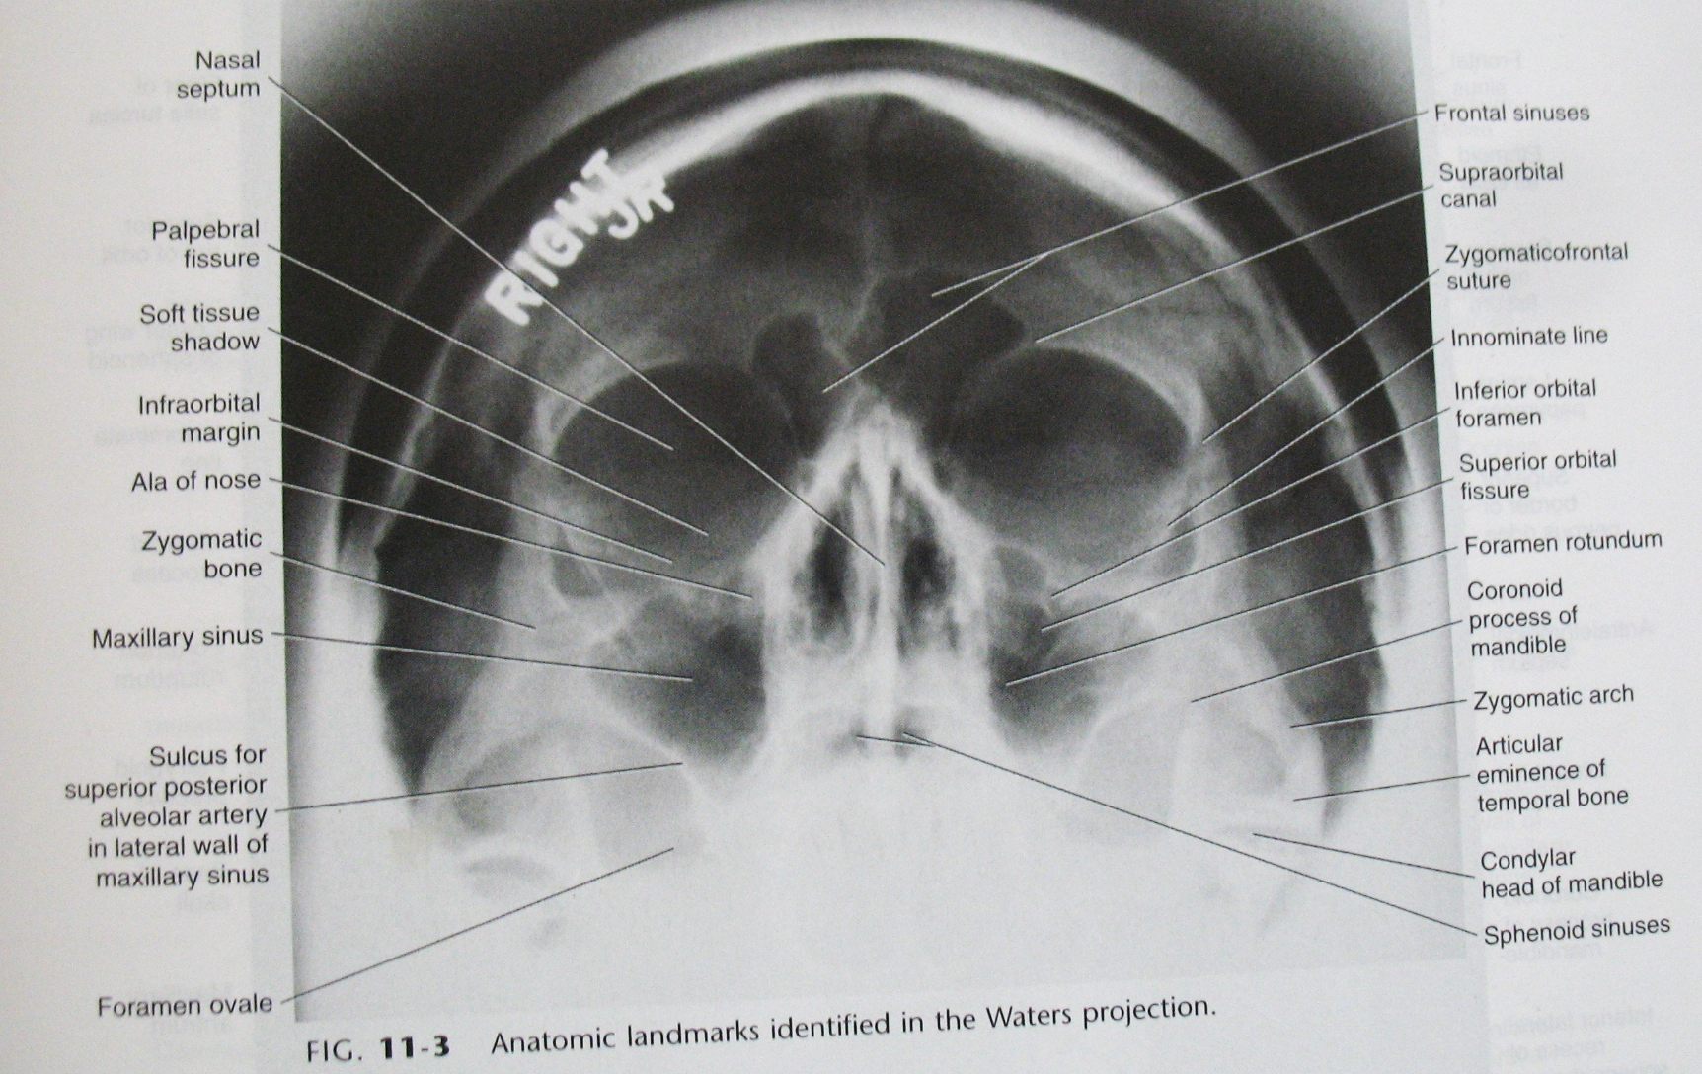

Slide 6
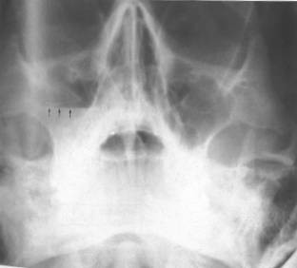
Fluid Level Within the Maxillary Sinus

Slide 7
irregular increase in opacity on the inner aspect of the walls
of the right antrum (arrowed), Mucosal Thickening

Slide 8
orbital blow-out fracture of the right orbital floor/antral roofshowing the downward herniated contents of the orbit into the antrum (arrowed), the so-called hanging drop appearance./ Tear Drop sign

Slide 9
McGrigor & Campbell (1950, referred as Campbell's lines

Slide 11
Trapnell line

Slide 12
Curve I - Lateral wall of the antrum and the inferior surface of the body of the zygoma & zygomatic arch
Curve 2 - Superior margin of the zygomatic arch and the lateral aspect of the body of the zygoma and orbital margin
Curve 3 - Inner aspect of the orbital rim
Curve 4 - Outer curvature of the nasal complex

Slide 13
Dolan’s line
Line 1: orbital line
Line 2: zygomatic line
Line 3: maxillary line

Slide 15
Water’s view
Main indications
Investigation of the maxillary antra
Detecting the following middle third facial fractures:
— LeFortI
— Le Fort II
— Le Fort III
— Zygomatic complex
— Naso-ethmoidal complex
— Orbital blow-out
Coronoid process fractures
Investigation of the frontal and ethmoidal sinuses
Investigation of the sphenoidal sinus (projection needs to be taken with the patient' s mouth open).

Slide 16
Reverse towne view

Slide 18
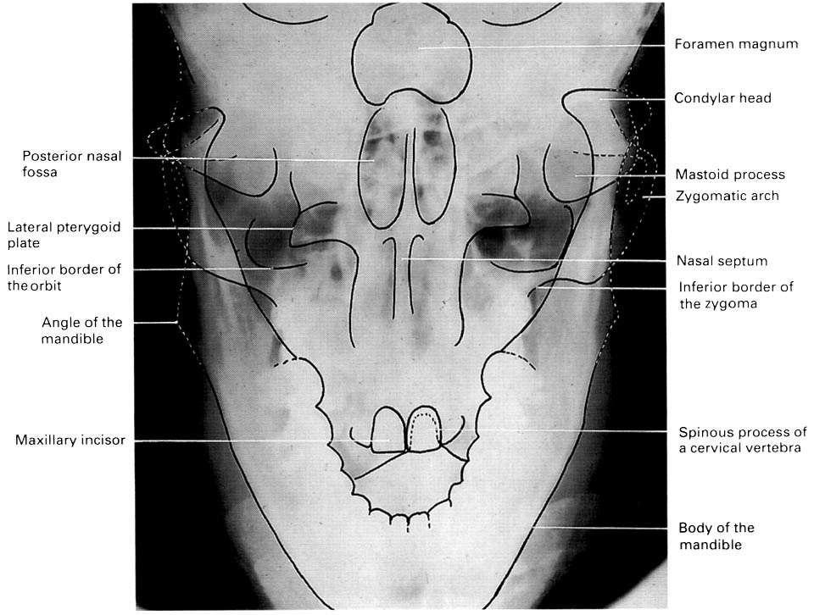

Slide 19
Reverse towne view
Indications
High fractures of the condylar necks
Intracapsular fractures of the TMJ
Investigation of the quality of the articular surfaces of the condylar heads in TMJ disorders
Condylar hypoplasia or hyperplasia

Slide 20
PA view

Slide 21
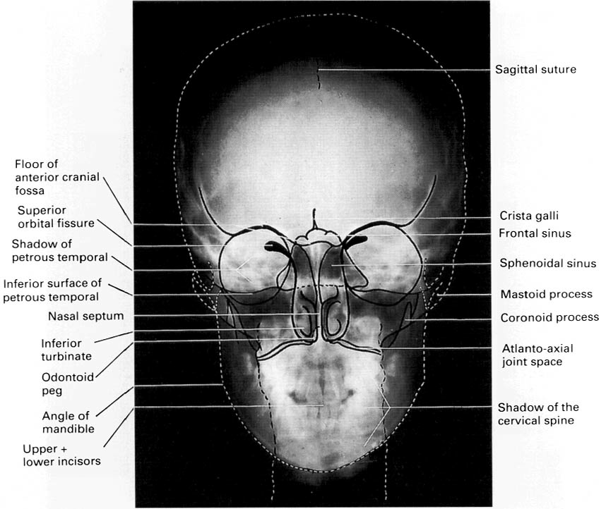

Slide 22
PA Mandible

Slide 23
PA view
Indications PA Skull
Fractures of the skull vault
Investigation of the frontal sinuses
Conditions affecting the cranium, particularly:
Paget's disease
multiple myeloma
hyperparathyroidism
Intracranial calcification.
Indications PA Mandible
Fractures of the mandible involving the following sites:
Posterior third of the body
Angles
Rami
Low condylar necks
Lesions in the posterior third of the body or rami
Mandibular hypoplasia or hyperplasia

Slide 24
SMV View
Contraindicated in patients with suspected neck injuries, especially suspected fracture of the odontoid

Slide 25
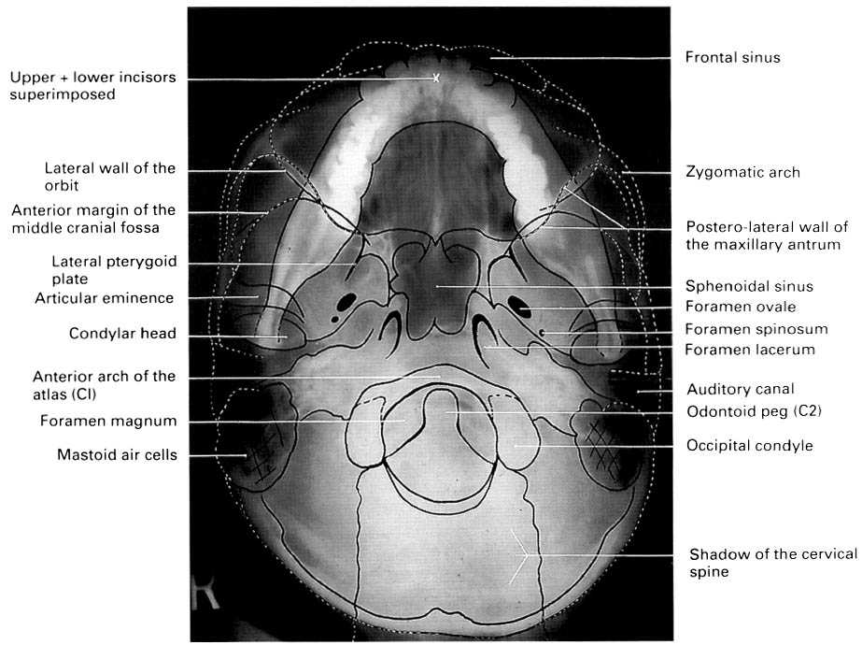

Slide 26
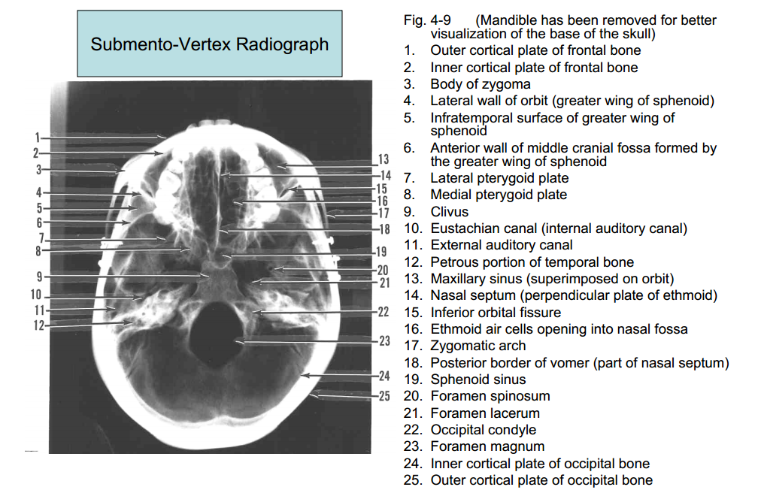

Slide 27
Jug handle view

Slide 29
SMV View
Indications
Destructive/expansive lesions affecting the palate, pterygoid region or base of skull
Investigation of the sphenoidal sinus
Assessment of the thickness (medio-lateral) of the posterior part of the mandible before osteotomy
Fracture of the zygomatic arches (SMV is taken with reduced exposure factors)

Slide 30
Lateral ceph

Slide 32
Lateral ceph
Indications
Orthodontics
Initial diagnosis
Treatment planning
Monitoring treatment progress
Appraisal of treatment results
Orthognathic surgery.
Preoperative evaluation of skeletal and soft tissue patterns
Treatment planning
Postoperative appraisal of the results of surgery

Slide 33
Lateral oblique ramus

Slide 35
Lateral oblique body

Slide 37
Lateral oblique View
Indications
Assessment of the presence and/or position of unerupted teeth
Detection of fractures of the mandible
Evaluation of lesions or conditions affecting the jaws
As an alternative when intraoral views are unobtainable because of severe gagging or if the patient is unable to open the mouth
As specific views of the salivary glands or temporomandibular joint

Slide 39
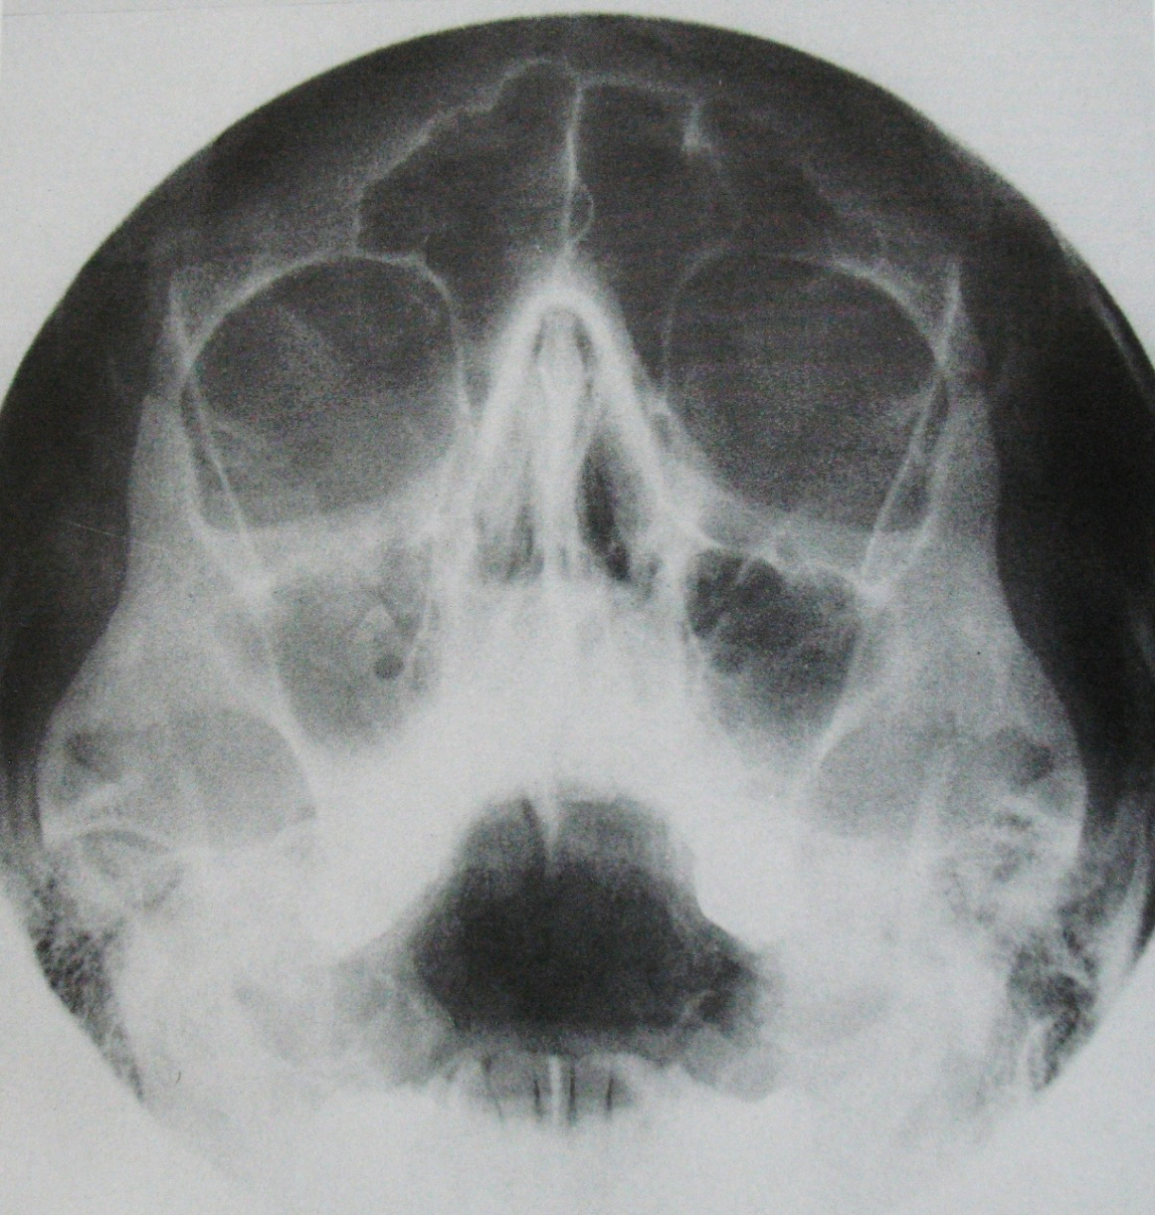
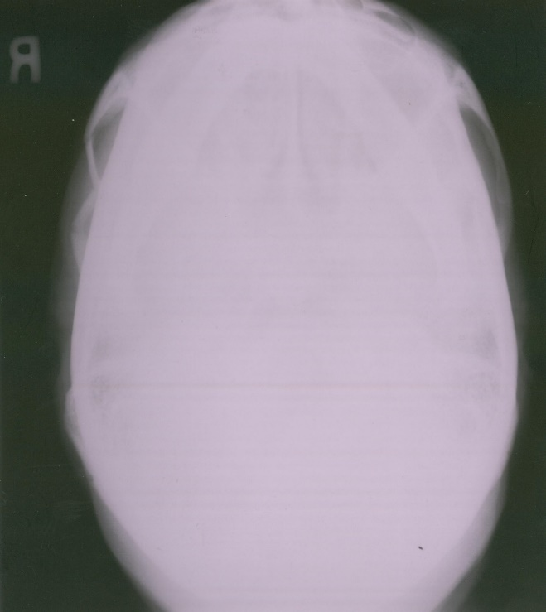
B
A
C
D

Slide 40
Thank you

