Slide 1
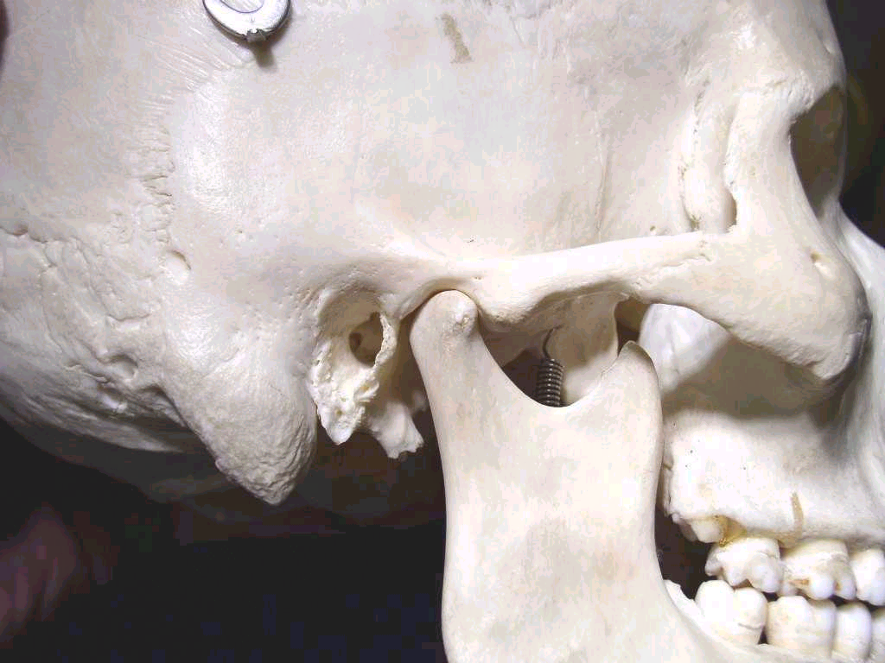
TEMPOROMANDIBULAR DISORDERS …

Slide 2
Contents
Introduction
Functions
Anatomy
Clinical aspects
Joint movements
Movements of mandible
Effect of occlussion and posture
TMJ disorders
    Etiology
    Classification
    Steps in assessment
    Diagnostic imaging
    General principles of treating TMDs
    Specific disorders and their management.

Slide 3
Introduction
Ginglymus = hinge joint,
Allowing motion only backward and forward in one plane,
Arthrodia, = gliding motion of the surfaces.
TMJ is a Ginglymoarthrodial joint

Slide 4
TMJ: A unique joint ??
Bilateral diarthrosis – right & left function together
Only joint in human body to have a rigid endpoint of closure that of the teeth making occlusal contact.
Articular surface covered by fibrocartilage instead of hyaline cartilage

Slide 5
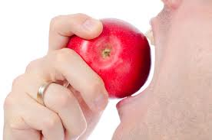



What do we need TMJ for ?
Functions.
Suckling
Speaking
Cutting
Grinding food
Swallowing

Slide 6
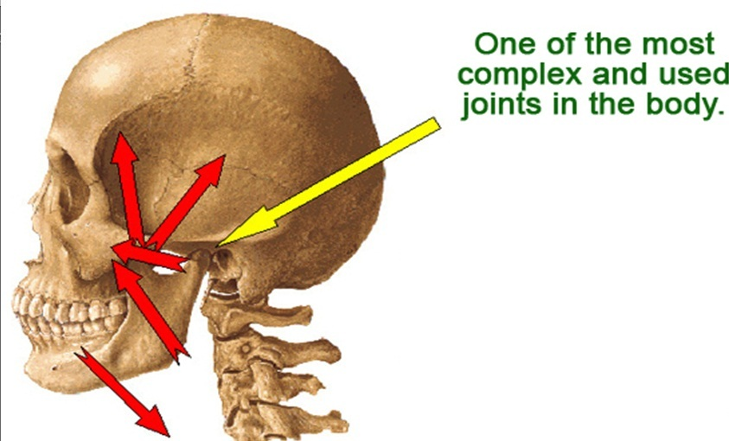

Slide 7
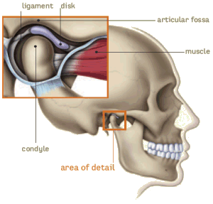
Anatomy

Slide 8
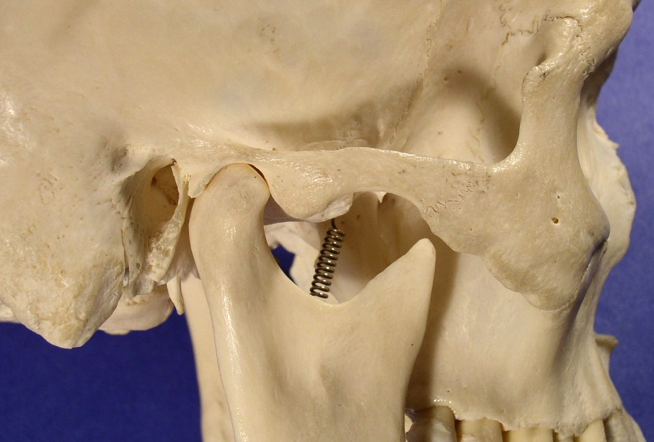
Bone-
temporal and condylar

Slide 9
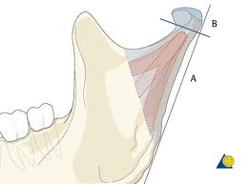
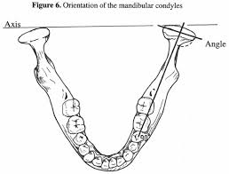
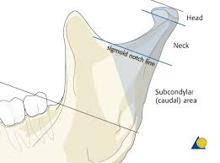
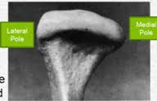
CONDYLE

Slide 10
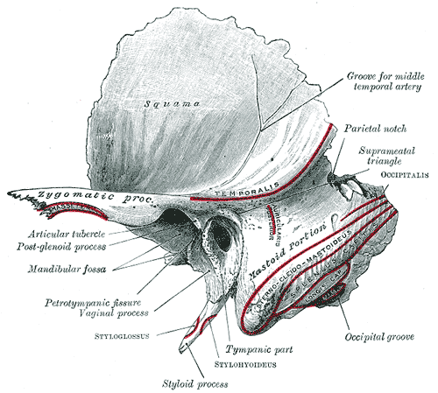
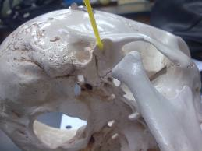
Mandibular fossa

Slide 11
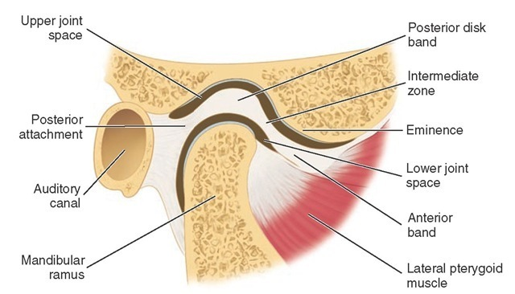
Articular disc

Slide 12
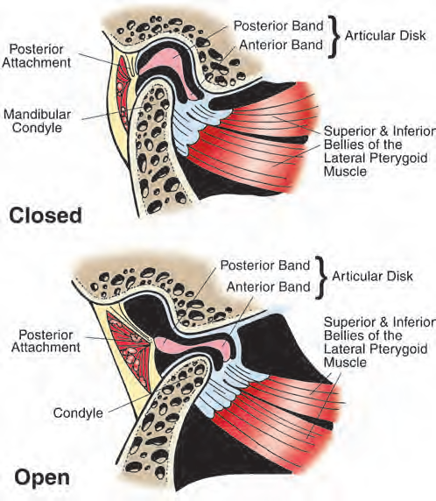

Slide 13
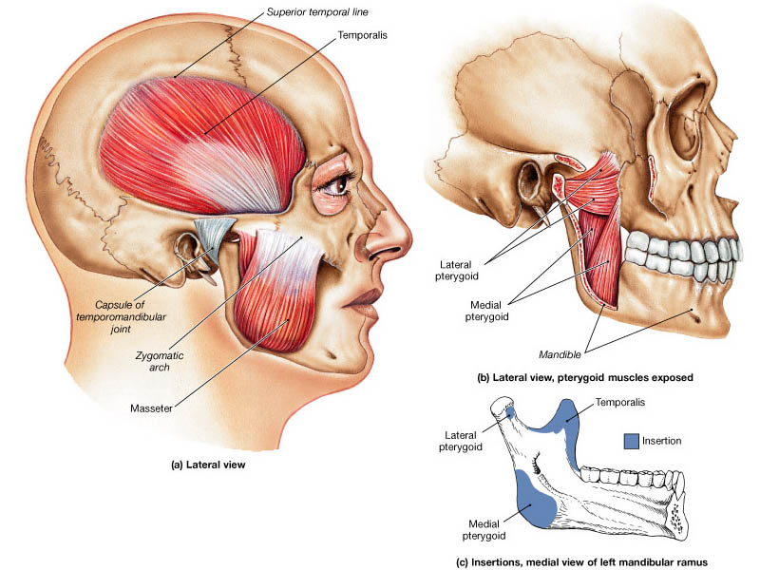
Muscles

Slide 14
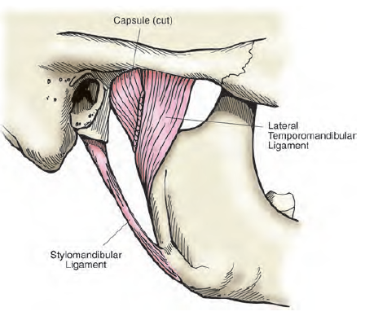
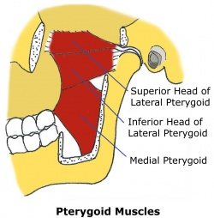
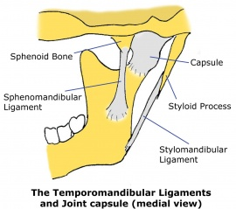
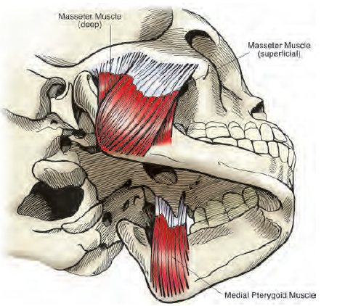
Muscle attachment

Slide 15
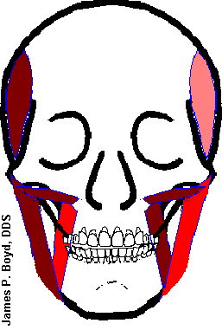
Movements of mandible
Depression
  Lateral pterygoid
  Digrastric
  Geniohyoid
  Mylohyoid
Elevation
  Temporalis
  Masseter
  Medial
  Pterygoids
Retraction
  Posterior fibres of Temporalis
Protrusion
  Lateral Pterygoids
  Medial Pterygoids

Slide 16
Joint movements……
Rotational / hinge movement in first 20-25mm of mouth opening
Translational movement after that when the mouth is excessively opened.

Slide 17
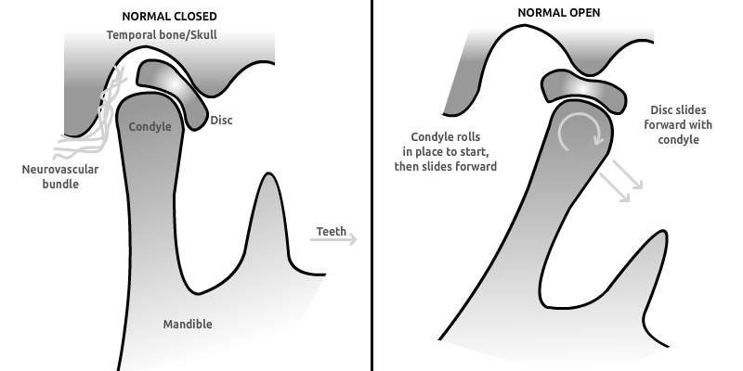

Slide 18
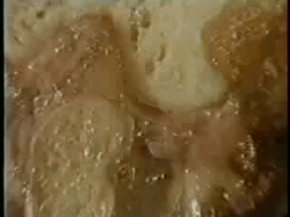

Slide 19

Temporomandibular disorders
Temporomandibular disorders is a collective term embracing a number of clinical problems that involve the masticatory muscles, temporomandibular joint and associated structures.

Slide 20

Etiology
Occlusal disharmony
Psychological distress
Masticatory muscle hyperactivity
Parafunctional habbits
Acute trauma to the jaw
Comorbidity of other rheumatic or musculoskelatal disorders

Slide 21
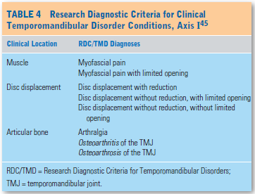
Classification

Slide 22
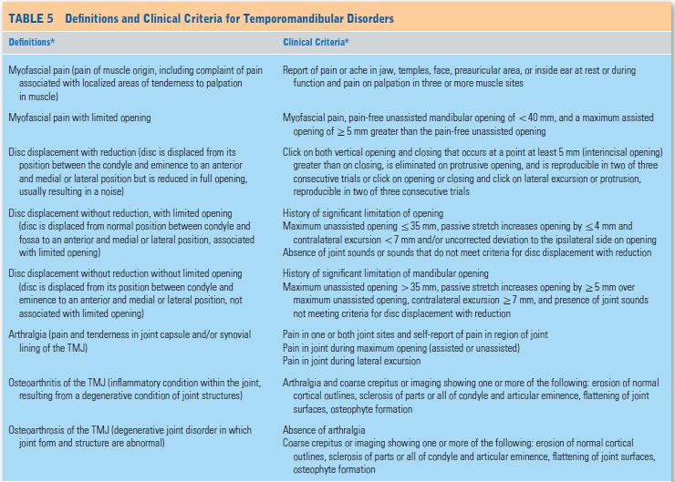

Slide 23
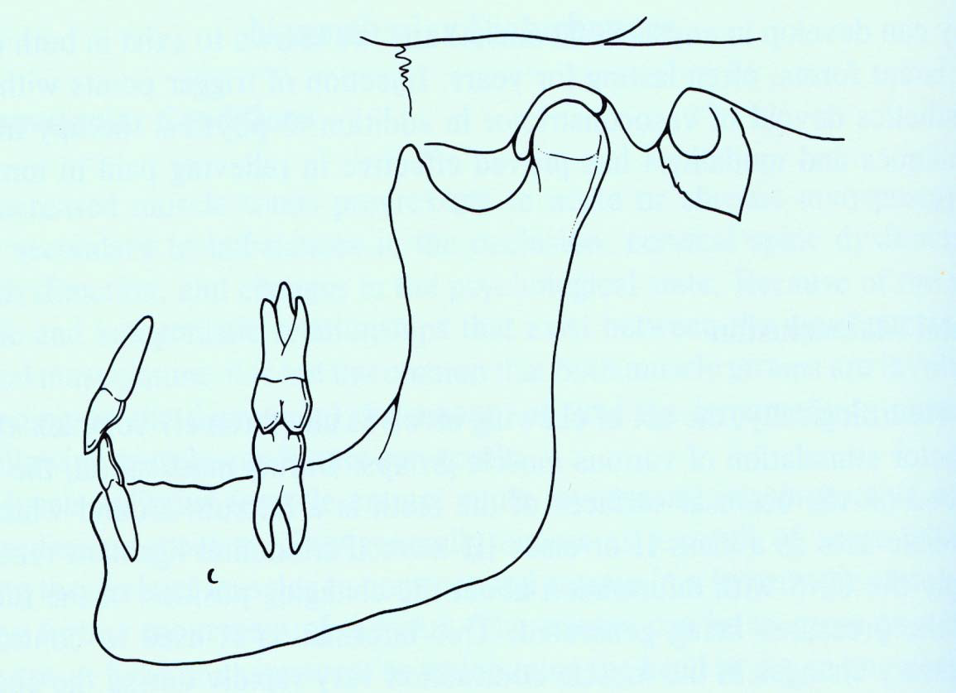
The Effect of Occlusion on Resting Posture of TMJ ‐Normal
Normal Intermolar relationship (red).
Allows Normal seating of Mandible‐disc‐condyle relationship (blue).

Slide 24
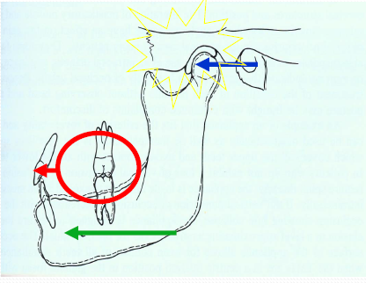
The Effect of Occlusion on Resting Posture of TMJ ‐Pathological
Poor occlusion between molars (red).
Places anterior stress on the disc of the TMJ.
Pulls mandible forward (green).
Jaw and facial pain.

Slide 25
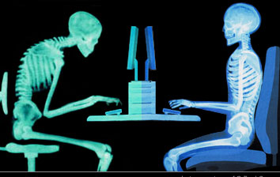
Effect of posture
Increase forward head posture.
•Stiff posterior neck musculature will rotate the cranium backward leaving the mouth open at rest.
•Muscles of mastication overwork to maintain jaw closure resulting in MPDS .

Slide 26
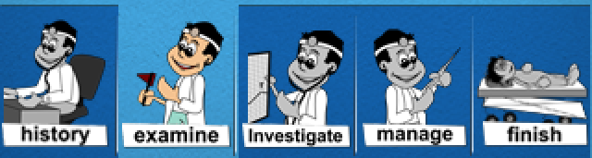
Steps in assessment
Behavioural assessment
History
Physical examination
Range of mandibular movement
Palpation of masticatory muscles
Palpation of cervical muscles
Palpation of TMJ
Provocation tests
Assessment of parafunctional habits
Diagnostic imaging

Slide 27

Behavioural assessment
Patients can be divided into 3 unique subgroups:
Dysfunctional patients
Interpersonally distressed
Adaptive copers
Psychosocial assessment provides the clinician with an appreciation of extent to which pain and dysfunction interfere with patient’s quality of life.

Slide 28
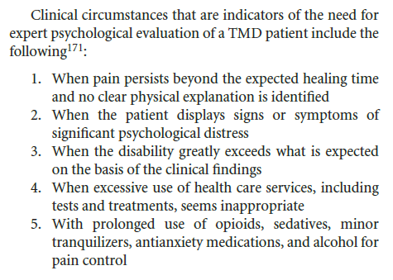

Slide 29
History
Most common symptom is pain.
The severity and intensity of pain can be measured using VAS (visual analogue scale).
A pain diary can be maintained to record events of increase or decrease in pain.
A questionairre can be used to ask patient about the history of pain or discomfort.

Slide 30

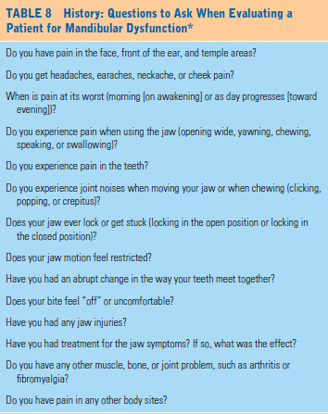

Slide 31
Physical examination
Masticatory muscle tenderness on palpation is the most consistent examination feature present in TMDs.

Slide 32
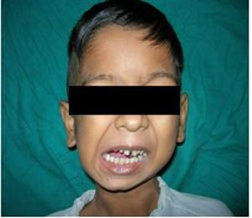
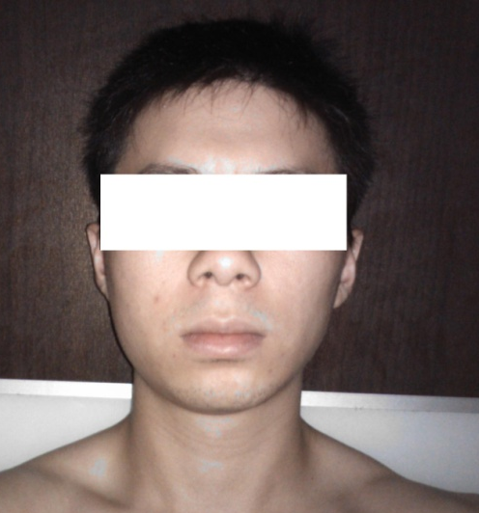
Steps in physical examination
Inspection :
Facial asymmetry
Swelling
Masseter and temporal muscle hypertrophy
Opening pattern-
corrected and uncorrected deviations,
uncoordinated movements and limitations.

Slide 33
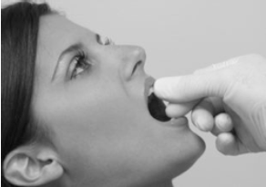
Range of mandibular movement:
Interincisor separation plus or minus the incisor overlap in centric occlussion provides the measurement of mandibular movement.
Assisted opening can be compared with active opening.
Muscle restrictions while assisted opening are associated with soft end-feel and result in increase of >5mm above the active opening.
Joint disorders have a hard end-feel and limit assisted opening to <5mm .

Slide 34
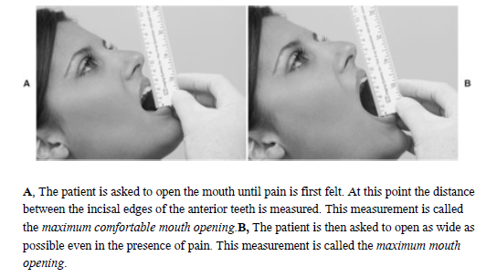

Slide 35
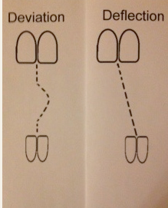

Slide 36
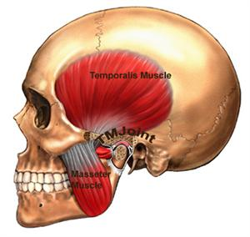
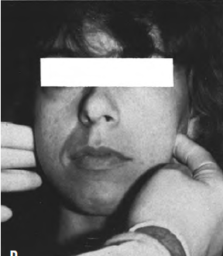
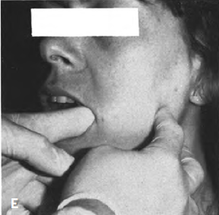
Palpation of masticatory muscles:
Masseter

Slide 37
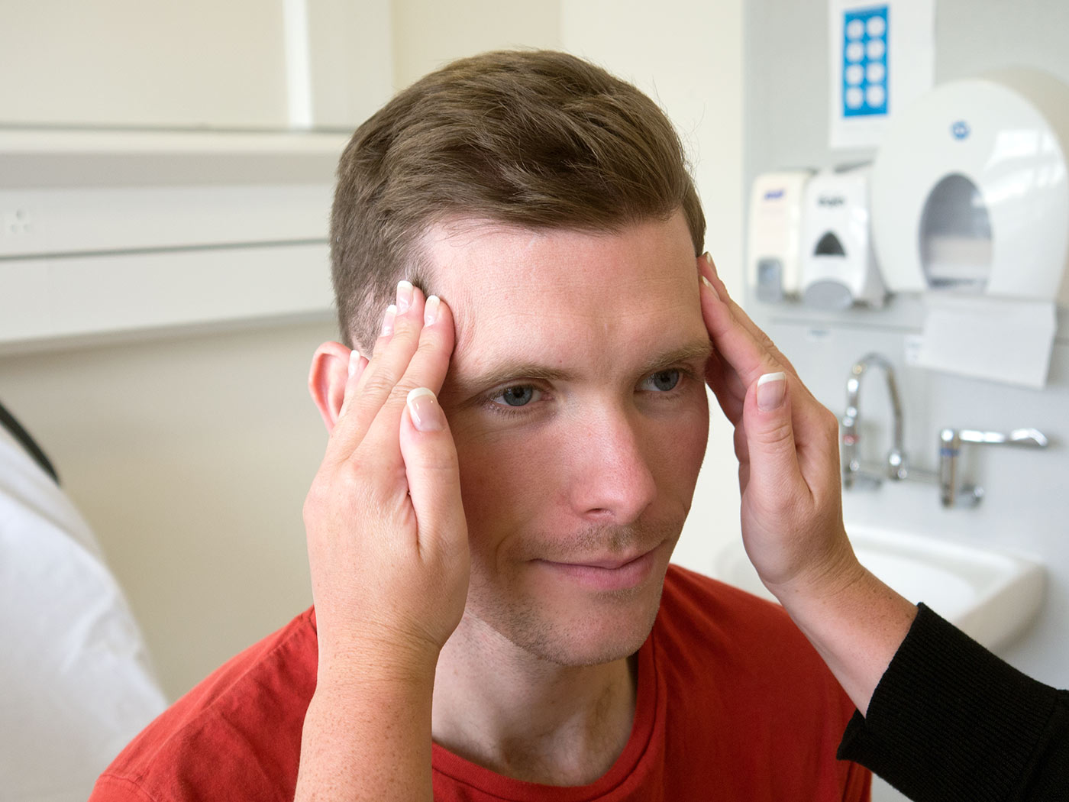
Temporalis

Slide 38
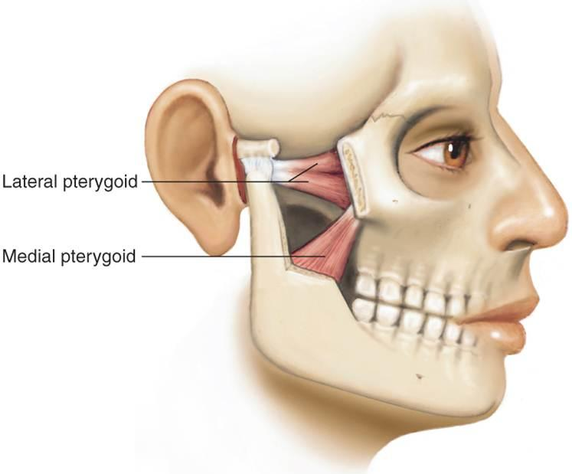
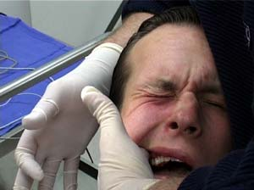
Lateral pterygoid muscle

Slide 39
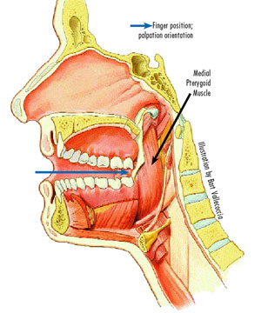
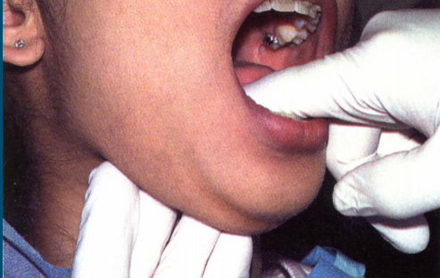
Medial pterygoid muscle

Slide 40
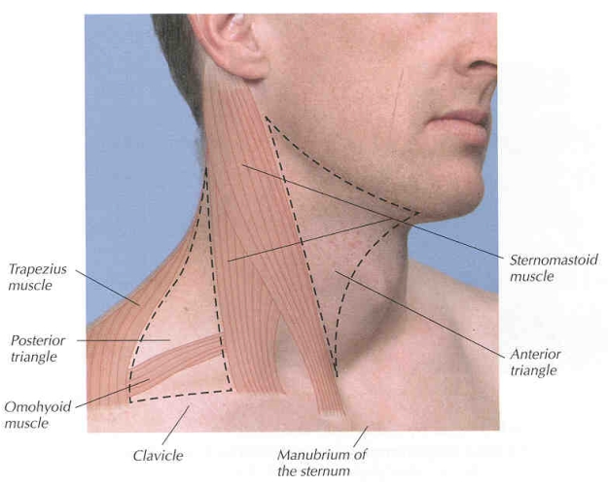
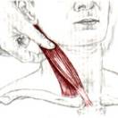
Palpation of cervical muscles
Sternocleidomastoid and trapezius muscles are often a part of cervical muscle disorder and refer pain to face and head.
Prevertebral (scalene) and suboccipital muscles should also be paid attention.

Slide 41
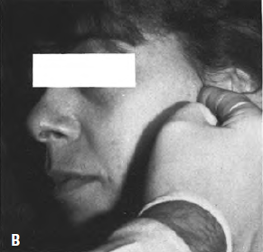
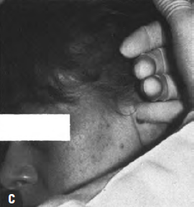
Palpation of TMJ
Pain
Clicking
Crepitus
Palpating anterior and posterior to lateral pole detects pain associated with capsular ligament.

Slide 42
Palpation of TMJ
A click that is felt on opening and closing and is eliminated by bringing the mandible into protrusive position before opening is mostly associated with ADD with reduction.
A condyle that does not translate may not be palpable during mouth opening and closing. This may be associated with ADD without reduction.

Slide 43
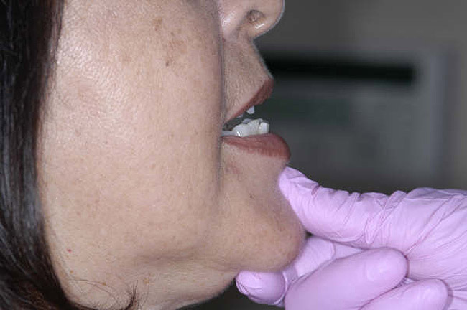

Provocation tests
The static pain test – patient has the mandible slightly open and remaining in one position while the patient resists the slowly increasing manual force applied by examiner in lateral, upward and downward direction.

Slide 44

Assessment of parafunctional habits
Self report
Monitoring day-time jaw activity and tooth positions
Reports by sleeping partners.
Assessing tooth wear, soft tissue changes (lip or cheek chewing),
An accentuated occlussal line
Scalloped tongue borders
Hypertrophic jaw closing muscles

Slide 45
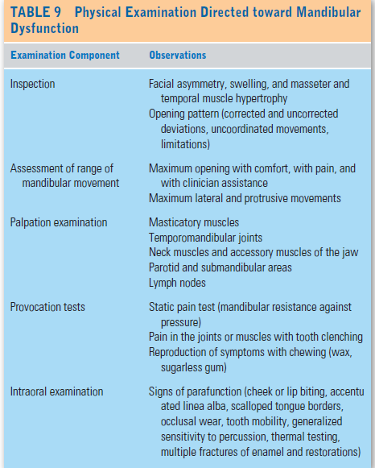

Slide 46
Diagnostic imaging of TMJ
Plain film radiography
Tomography
Arthrography
Computed tomography -
MRI-
Single photon emission computed tomography
Radioisotope scanning
for osteodegenerative joint diseases.
to assess disc form and position.

Slide 47
OBJECTIVES OF TMJ IMAGING
-To understand anatomy and pathophysiology of TMJ.
To depict clinically suspected disorders of TMJ.
To stage the progression of known disease.
-To screen for unsuspected pathology
-To evaluate the effects of a given treatment.
.To help evaluate the range of motion of the joint.
-To confirm the extent of known disease

Slide 48
IMAGING PROTOCOL
Examination of bone usually precedes that of soft tissue.
To evaluate osseous contours- shape and internal structure of
condylar head, neck and temporal bone.
To illustrate the relationship of the condyle to the glenoid fossa
and articular eminence in mandibular open and closed positions.
To depict the range of motion.

Slide 49
The objectives of soft tissue investigation should be the following-
To provide information about disk position, morphology and
integrity.
To image abnormalities in the muscle and surrounding tissues.

Slide 50
TMJ IMAGING CONTD.
Conventional Techniques
Transcranial
Transpharyngeal
Transorbital
Panoramic radiograph
Skull views
Lateral oblique view ( Ramus
of Mandible)
Tomography
Advanced techniques
Arthrography
Arthroscopy
Ultrasonography
Colour Doppler ultrasonography
Computed tomogoraphy
Magnetic resonance imaging
Radionuclide Imaging
C.B.C.T

Slide 51
Diagnostic Imaging of the TMJ
OSSEOUS STRUCTURES
SOFT TISSUE STRUCTURES
CONVENTIONAL
1.PANORAMIC
2.PLAIN FILM MODALITIES
3. CONVENTIONAL TOMOGRAPHY
ADVANCED
4.COMPUTED TOMOGRAPHY
5.CBCT
ADVANCED
1.ARTHROGRAPHY
2.MRI

Slide 52
O.P.G
Conventional panoramic radiography has been used as a screening tool for the entire maxillo mandibular region, including the TMJ.
INDICATIONS
TMJ pain dysfunction syndrome.
To investigate disease within the joint.
To investigate pathological conditions affecting the condylar heads.
Fractures of the neck and head of the condyle.
Condylar hypo/hyperplasia .

Slide 53
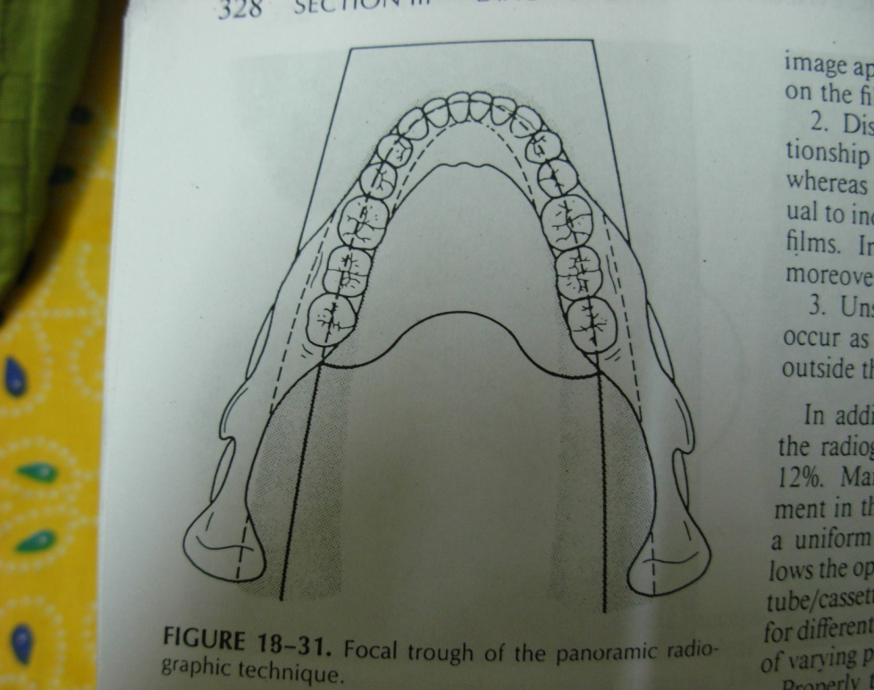
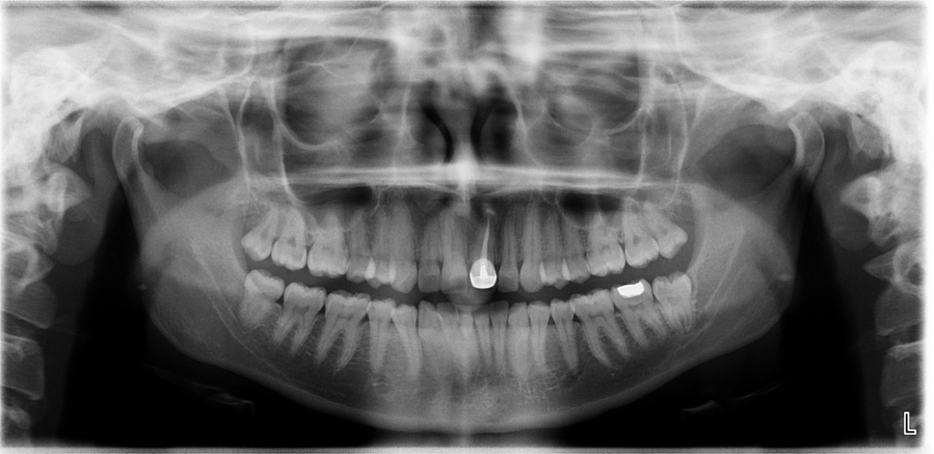
Focal Trough of Panoramic Machine
Diagnostic information:
The information provided includes
The shape of the condylar heads and condition of the articular
surfaces from the lateral aspect.
A direct comparison of both condyles
Normal Panoramic Radiograph

Slide 54

Panoramic radiograph- TMJ program
Separate images are taken of the left and right sides with
projections taken on film for open and closed TMJ
positions.
OPG – TMJ Program(TMJ Field limitation view)

Slide 55
PLAIN FILM RADIOGRAPHY
Main projections include
1.Transcranial
2.Transpharyngeal
3.Transorbital
4.SMV(basal)

Slide 56
TRANSCRANIAL RADIOGRAPHY
Schuller in 1905.
It provides a reasonably true projection through the long axis of the joint.
INDICATIONS:
TMJ pain dysfunction syndrome & internal derangements of the joint producing pain, clicking and limitations in mouth opening
To investigate the size and position of the disc
To investigate the range of movement in the joints.
Helps to evaluate the joints bony relationship.
Displaced condylar fractures

Slide 57


Technique and positioning:
1.The X-ray film cassette: Parallel to the sagittal
plane.
2. The X-ray tube: on the contralateral side of the skull
3.Central beam: projects downwards 25 ° & anteriorly 20° (centered on the TMJ).
4. The central beam is projected across the cranium above the petrous ridge of the temporal bone

Slide 58


Slide 59
Diagnostic information:
Closed view includes:
The size of the joint space
The position of the head of the condyle within the fossa.
The shape and condition of the glenoid fossa and articular eminence (on the lateral aspect only).
A comparison of both sides.
Open view includes:
The range and type of movement of the condyle
A comparison of the degree of movements on both the sides.

Slide 60

Normal transcranial rt TMJ. i)mouth closed ii)mouth open

Slide 61
Transpharyngeal radiography
Infracranial, Parma, or Mc Queen projection
Indications:-
To investigate the presence of joint disease, particularly
osteoarthritis and rheumatoid arthritis.
To investigate pathological conditions affecting the condylar
head, including cysts or tumors.
Fractures of the neck and head of the condyle.

Slide 62

Technique and positioning:
The X-ray film : parallel to the sagittal plane of the head.
The X-ray tube head is positioned in front of the opposite condyle It is aimed through the sigmoid notch, below the base of the skull base
3.The central beam: cranially 5-10 ° & posteriorly approx 10 °
4. A 30-35 mm mouth prop facilitates translating the condyle to the height of the eminence and opens the mandibular notch on the contralateral side to allow free passage of the beam.

Slide 63


Slide 64

Diagnostic information:
The shape of the head of the condyle and the condition of the articular surface from the medial aspect.
A comparison of both condylar heads.

Slide 65
TRANSORBITAL RADIOGRAPHY
Zimmer projection, transmaxillary, transantral, or infraorbital technique
INDICATIONS:-
It is most routinely successful in delineating the joint with minimal superimpositions.
It is a frontal projection of the entire medio-lateral extent of the
condyle

Slide 66

Technique and positioning:
Seat the patient upright and tip the head downward about 10 degrees so the canthomeatal line is horizontal.
Central ray :through the ipsilateral orbit and through the TMJ of interest, exiting from the skull behind the mastoid process.
X-ray cassette :behind the patient’s head so that the central ray is projected to its center and perpendicular to it.
Then ask the patient to open the mouth as wide as possible to move the condyle of interest out of the articular fossa and onto the crest of the articular eminence.

Slide 68
Diagnostic information:
Demonstrates the convex articulating surface of the condyle and slightly concave or flat, broad ridge of the articular eminence.
Visualization of the entire mediolateral range of the articulating surfaces of both the condyle and the articular eminence

Slide 69
REVERSE TOWNE’S VIEW
Main indications :
To investigate the articular surface of the condyles and disease
within the joint.
Unilateral or bilateral fractures of the condylar head and neck,
Visualize the medial displacement of condylar fragments.
Condylar hypo/hyperplasia

Slide 70

Technique and positioning:
The cassette: perpendicular to the floor in a cassette holding device.
The head centered in front of the cassette ;canthomeatal line oriented downwards -30°
To help visualize the condyles
the patient must open his mouth
as wide as possible .

Slide 72

Diagnostic information:
The information provided includes
The shape of the condylar heads and condition of the articular
surfaces from the posterior aspects.
A direct comparison of both condyles .

Slide 73
SUBMENTOVERTEX VIEW
Indications
To reveal condylar displacement and rotation in the horizontal plane associated with trauma or orthognathic surgery.
To study facial asymmetry – condylar hypoplasia or hypertrophy.
Used as a scout film for corrected tomography technique.

Slide 74

SUBMENTOVERTEX VIEW
Technique to take radiograph on Intraoral radiographic machine
Film position - The cassette is placed parallel to the patient’s transverse plane and perpendicular to the mid-sagittal plane
Position of patient – The patient’s neck is extended as far backwards as possible
Central ray – Is directed perpendicular to the cassette, from between the angles of the mandible towards the vertex of the skull and in a coronal plane 3/4th inches anterior to the external auditory meatus

Slide 75

Area of the joint seen
Axial inclination of the mandibular condylar head.
Normal Submentovertex Radiograph

Slide 76
CONVENTIONAL TOMOGRAPHY
Indications:-
1.Full assessment of the whole of the joint to determine the presence and site of any bone disease or abnormality.
2.To investigate the condyle and the articular fossa when the patient is unable to open mouth
3.Assessment of fractures of articular fossa and intracapsular fractures

Slide 77
Tomography of Temporomandibular joint
The conventional tomography has been used extensively to
evaluate the osseous components of the TMJ.
A lateral projection is the initial and often the only view necessary.
Both sides, with open and closed mouth positions, are always done for comparison. If there is a question of fracture, check the closed mouth view before proceeding.
A frontal view is used in conjunction with the lateral view in cases
suspected of having a fracture or dislocation.

Slide 78


Sagittal tomogram of TMJ. The condyle (C), fossa (F), and tubercle (T)

Slide 79
Advantages
To assess condylar position.
To reveal osseous changes those are not apparent in conventional
films.
To define the extent of bone involvement in patients with arthritis
or neoplasms.
DISADVANTAGES
Lack of visualization of the soft tissue of TMJ
Tomographic blurring decreases the sharpness of the image.
High radiation dose.

Slide 80
COMPUTED TOMOGRAPHY
CT scanners use X-rays to produce sectional or slice images, as in
conventional tomography but the film is replaced by very sensitive crystal or gas detectors.
INDICATIONS
Determining the presence and extent of ankylosis and neoplasms.
Reveals minute bony details such as erosions or small sequestra.
Extent of bone involvement in arthritides.
Imaging complex fractures.

Slide 81
Standard Imaging Planes Used in CT Scanning
Direct sagittal CT of the TMJ

Slide 82
ARTHROGRAPHY
Was the 1st imaging technique capable of providing information on joint soft tissue status.
A technique in which an indirect image of the disk is obtained by injecting a radiopaque contrast agent into one or both joint spaces under fluoroscopic guidance.
Following injection of the contrast medium, a dynamic evaluation of the patient’s joint function can be made using fluoroscopic imaging .
A linear, sagittal, tomographic series is then taken to image the
TMJ from medial to lateral.

Slide 83

INDICATIONS
Assessment of disk position, function, morphology.
Integrity of the discal attachment.
Establish a jaw position for protrusive splint therapy.
Long-standing TMJ pain dysfunction unresponsive to conservative treatment
Persistent history of locking
Limited opening of unknown etiology
Needle Position For Injecting Inferior & Superior Joint Spaces

Slide 84
Infrequent indications
Diagnosis of loose bodies in the joint space
Evaluation after trauma
Aspiration of joint fluid
Intra-articular injection.
Diagnosis of adhesions
CONTRAINDICATIONS
Infections in the preauricular area.
Allergy to contrast media.
Bleeding disorder.
Anticoagulation medication

Slide 85
A, Single-contrast arthrogram of a normal TMJ with contrast injection into the lower joint compartment only. The small anterior recess of the lower joint compartment (arrow) suggests a normal superior disk position.
B, Normal TMJ demonstrated by a single-contrast arthrogram with contrast injection into both the upper and lower joint spaces. The condyle (C), fossa (F), and tubercle (T) are indicated. The arrow indicates the anterior recess of the lower joint space
A, Normal TMJ with double-contrast arthrotomography in the closed-mouth position. The posterior band (arrow) of the disk is located over the condyle.
B, Normal TMJ double-contrast arthrotomography in the open-mouth position. The posterior band (arrow) of the disk is located posterior to the condyle.

Slide 86
ARTHROSCOPY
Arthroscopy is a technique of introducing an optical instrument into the joint allowing direct visual examination of its internal surfaces.
Indications
The upper joint compartment can be examined for synovitis
Displacement of the meniscus, adhesions between meniscus and the
joint fossa can be viewed.
Displacement of the disc without reduction can be verified by its
stretched bilaminar tissue .

Slide 87

TECHNIQUE
Performed under G.A.with percutaneously installed trocars and an optical probe of 1.9–2.4 mm diameter.
The intraarticular picture is transmitted by a light cable onto the
screen.
The standard technique for TMJ arthroscopy is via a lateral
approach.
The upper joint compartment, is entered with a 21 gauge needle posteriorly.

Slide 88


1 = Superior anterolateral approach; 2 = endoaural approach; 3 = superior posterolateral
C= condyle; and G= glenoid fossa
A trochar and cannula are then introduced into the space created by the fluid in the joint.
The trochar is removed and replaced by the arthroscope.

Slide 89
ULTRASONOGRAPHY
Noninvasive and dynamic imaging technique to provide insight into the dynamics of the TMJ for a low cost, rapid, non-harmful and non-invasive alternative that has good diagnostic accuracy and reliability.
Positioning of the transducer and consequent visualization of the temporomandibular joint (TMJ). A. Horizontal positioning, transverse image of the TMJ. B. Vertical positioning, coronal/sagittal image of the TMJ (depending on the angulation of the transducer).

Slide 90
INDICATIONS
Evaluation of all the components of the TMJ:
condylar head, glenoid fossa of the temporal bone, disc
It is useful in evaluating condylar range of motion and also plays a
role in depicting inflammation of the TMJ .
Internal disc derangements.
Joint effusion

Slide 91

Ultrasonic image of a temporomandibular joint without any pathologic changes. The double arrows show the joint space. The arrow shows the disc (marked with small dots).
US of the TMJ.
Hyperechoic lines(white) represent the glenoid fossa (superior line) and condylar surface (inferior line), respectively.

Slide 92
M.R.I
INDICATIONS
When diagnosis of internal derangements is in doubt
Pre-op assessment before disc surgery.
Evaluation for joint effusion or damage to the retrodiscal tissues following trauma.
Useful for erosion of the bony components, granulation tissue associated with implants or excessive fibrosis of the joint capsule

Slide 93

Normal MR imaging, Normal TMJ. A, The posterior thick band (arrowhead ) is located immediately superior to the condylar head. Just anterior to this band is the central thin region. The low signal just anterior to the condylar head is the anterior thick band. The disk gives a ‘‘bowtie’’ appearance due to the anterior and posterior thick bands.
B, Open-mouth position. The mouth is slightly open. The disk has translated down anteriorly so that the anterior thick band of the disk is immediately inferior to the articular eminence (arrow). The condylar head has rotated with respect to the disk. Note how the posterior edge of the mandible has rotated posteriorly (arrowhead ) compared to A.

Slide 94
CBCT
CBCT, also known as volumetric CT (VCT), uses a cone- shaped X-ray beam.
The tube-detectors system performs a 360 ͦ rotation around the head of the patient using a constant beam angle.
This rotation produces the initial data, the so called raw data, which are presented as a lateral tomogram.
The raw data are used for primary reconstruction. The options for the thickness of the layers to be reconstructed are 0.3 mm, 1.0 mm, and 3.0 mm, and the reconstruction angles are determined by the clinician.
The primary images can be used for further secondary reconstructions in all planes and for three-dimensional (3D) reconstructions.

Slide 95

Film layout of a typical examination of the right temporomandibular joint. (a) Axial image, (b) lateral images perpendicular to the long axis of the condyle (closed mouth), (c) central lateral images (closed and open mouth), (d) coronal views parallel to the long axis of the condyle (closed and open mouth) and (e) three-dimensional reconstructions (closed and open mouth)

Slide 96
CBCT parasagittal and coronal slices: show clear images of
the condylar head and the glenoid fossa .
the lateral views: Developmental and pathological changes
The central lateral view defines the true position of the condyle
in the fossa,which often reveals possible dislocation of the disc
in the joint. (extent of translation of condyle in fossa )
A 3D reconstruction gives a general overview of the TMJ, sometimes valuable in cases with severe morphological abnormalities or for surgical planning.
Coronal view (open-mouth): clearer view of the condyle, since it translates slightly over the tubercle giving an unobstructed view of the condyle head.

Slide 97

Radioisotope scanning
For detecting increase in metabolic activity of bone.
Used to detect condylar hyperplasia.

Slide 98
DISEASES OF TMJ

Slide 99
DEVELOPMEMENTAL ABNORMALITIES
1.Condylar hyperplasia
2.Condylar hypoplasia
3.Juvenile Arthrosis
4.Coronoid hyperplasia
5.Bifid condyle

Slide 100
CONDYLAR HYPERPLASIA
Enlargement and occassional deformity of condylar head.
Secondarily affects mandibular fossa.
Etiology
Hormonal influences
Trauma
Infection
Heredity

Slide 101


Clinical features
M>F
Age -Before 20 yrs
Mandibular asymmetry
Chin may deviate to the unaffected side.
Due to growth of ramus and mandibular body, posterior open bite may be present.

Slide 102

Radiographic features
Condyle appears normal but symmetrically enlarged.
May be more radiopaque due to additional bone.
May have an altered shape, “inverted L”- is one of the patterns .
Cortical thickness and condylar patterns are normal.
Glenoid fossa may be enlarged.

Slide 103

1.Condylar Hyperplasia
Panoramic image of condylar hyperplasia involving rt condyle

Slide 104

Condylar Hyperplasia

Slide 105
Treatment
Orthodontics combined with orthognathic surgery.
Surgery should be performed before completion of condylar growth to avoid functional problems.

Slide 106
Condylar hypoplasia
Failure of condyle to attain normal size.
Condylar morphology is usually normal.
Etiology
May be inherited or appear spontaneously.
Injury to articular cartilage by birth trauma.
Intra-articular inflammatory lesion.

Slide 107

Clinical features
Mandibular growth deficiency and asymmetry
Congenital abnormalities may be associated with systemic disorders (treacher collins syndrome)
Chin and mandible deviates to affected side during opening.

Slide 108

Radiographic features
Condyle small in size, normal in shape.
Mandibular fossa is also small in size.
Posterior border of ramus and condylar neck have a posterior inclination.
Deep antegonial notch.

Slide 109

2.Condylar Hypoplasia
A panoramic film revealing hypoplasia of the left condyle. In this case the hypoplasia is restricted to the condylar head and neck with minimum involvement of the mandibular ramus and body.

Slide 110


Condylar Hypoplasia
3D CBCT left oblique lateral—shows hypoplasia of glenoid fossa and condyle
3D CBCT left lateral—shows hypoplasia of glenoid fossa and condyle.

Slide 111
Treatment
Orthognathic surgery
Bone grafts
Orthodontic therapy.

Slide 112

Bifid condyle
It has a vertical depression , notch or deep cleft in the centre of condylar head.
Appearance of double or bifid condylar head.
Unilateral

Slide 113

Bifid condyle

Slide 114


5.Bifid condyle
A
B
A, Sagittal tomogram showing a deep central notch with duplication of the condylar head (arrows). The glenoid fossa has remodeled (enlarged) to accomadate the abnormal condyle.
B. Coronal tomogram. Another example.-showing a depression in the centre of condylar head

Slide 115
Juvenile arthrosis
Boering’s arthrosis and Arthrosis deformans juvenilis.
Condylar hypoplasia –affected condyle was once normal ,becoming abnormal during growth.
May be unilateral or bilateral.
C/F:
Children and adolescents more affected.
F>M
Mandibular assymmetry may be present.
TMJ dysfunction

Slide 116

Radiographic features
“Toadstool” appearance of condylar head.
Condylar neck is shortened or absent
Temporal component is flattened.
Deepened antegonial notch.

Slide 117


3.Juvenile Arthrosis
Juvenile arthrosis. The condylar heads have a "toadstool" appearance and are posteriorly inclined. The condylar necks are absent.

Slide 118
Treatment
Orthognathic surgery
Orthodontic therapy.

Slide 119
SOFT TISSUE ABNORMALITIES
1.INTERNAL DERANGEMENTS
-Disc displacement
-Disc reduction and non reduction
-Perforation and deformities
-Fibrous adhesions and effusion

Slide 120

Articular disk disorders

Slide 121
Etiology :
Direct trauma to joint
Chronic low grade microtrauma-bruxism,clenching.
Generalized laxity of joint
Indirect trauma- from cervical flexion extension injuries or malocclussion
Clinical features :
Abnormal joint sounds- clicking, popping, crepitus
Limitation and deviation of mandibular motion.
Pain

Slide 122
Anterior disc displacement with reduction
Caused by an articular disc that has been displaced from its position on top of the condyle due to elongation or tearing of restraining ligaments.

Slide 123
Disc dislocation with reduction…
Opening movement of the condyle and opening click

Slide 124
Disc dislocation with reduction…
Closing movement of the condyle and reciprocal click

Slide 125


Slide 126

Examination :
Palpation and auscultation of TMJ will reveal a clicking or popping sound during both opening and closing mandibular movements (Reciprocal click)
Adapted from McNeill C

Slide 127

Research Diagnostic Criteria for Clinical
Temporomandibular Disorder Conditions, AxisI

Slide 128

Management
Patients with joint noises not accompanied by pain need no treatment.
Painful clicking – Flat plane stabilization splints that do not change mandibular position.
Anterior repositioning splints : maintain mandible in anterior position preventing condyle from closing posterior to disc.

Slide 129
Anterior disc displacement without reduction.
Also known as closed lock.
History of long standing TMJ click that abruptly disappears followed by a sudden restriction in mandibular opening.

Slide 130
Disc dislocation without reduction…
CLOSED LOCK

Slide 131


Slide 132
On examination
Limited mandibular opening
Pain over joint (esp. at maximal opening)
Limited lateral movement.
During maximum opening, mandible deviates towards the affected side.
Condyle on affected side will not translate and will not be palpable.
Chronic closed lock- disc deforms and maximum mouth opening gradually improves.

Slide 133
Management
Restricted movements- manual manipulation and mandibular motion exercises.
Decrease adverse effect of bruxism- occlussal splint.
Anti-inflammatory drugs.
Arthrocentesis can be helpful in severe pain cases.
Flushing of joint and deposition of intra-articular corticosteroids to decrease inflammation .
Sodium hyaluronate –to decrease adhesions and increase joint lubrication.

Slide 134

Posterior disc displacement
Condyle slipping over the anterior rim of disk during opening with the disk being caught and brought back in abnormal relationship to condyle when closed.

Slide 135
REMODELING AND ARTHRITIC CONDITIONS
Degenerative joint disease
Rheumatoid arthritis
Juvenile arthiritis

Slide 136
TMJ arthritis
Osteoarthritis (Degenerative joint disease)
Disorder of articular cartilage and subchondral bone, with secondary inflammation of synovial membrane.
Primary
Unknown origin, genetic factors play an important role
>50yrs ,often asymptomatic
Secondary
Caused by trauma, congenital dysplasia or metabolic disease

Slide 137
Clinical Manifestations
Incidence increases with age.
Pain directly over the affected condyle
Limitation of mandibular opening.
Feeling of stiffness after a period of inactivity.
On Examination
Tenderness and crepitus on intra-auricular and pretragus palpation.
Deviation of mandible towards painful side.

Slide 138
Radiographic features
Osseous changes- CT images
Gross changes- T1 weighted MRI images
In maximum intercuspation, the joint space may be narrow or absent, correlating with an internal derangement and frequently with perforation of the disk or posterior attachment, resulting in bone to bone contact.

Slide 139


Radiographic features
Flattening, subchondral sclerosis are signs of previous remodelling.
Loss of cortex, erosions of articulating surfaces of condyle or temporal component.

Slide 140

Radiographic features
Deep to the articulating surfaces , small round radiolucent areas with irregular margins are visible deep to articulating surfaces and are called as “Ely”.

Slide 141


Radiographic features
Later in couse of disease, osteophyte formation is seen.
Osteophyte may break and lie free within joint space as “joint mice”

Slide 142

Management
Relieving joint stress- splint therapy.
Relieving secondary inflammation – anti-inflammatory drugs.
Increasing joint mobility and function – physiotherapy.

Slide 143
Rheumatoid arthritis
Heterogenous group of systemic disorders that manifest mainly as synovial membrane inflammation in several joints.
TMJ is involved in 40 -80 % of patients.
Vasculitis of synovial membrane
Chronic inflammation marked by intense round cell infiltrate and formation of granulation tissue
Cellular infiltrate causes erosion of underlying bone.
Step 1
Step 2
Step 3

Slide 144
Clinical manifestations
Bilateral TMJ involvement.
Pain usually in early acute stages.
Morning stiffness.
Joint sounds.
Tenderness and swelling over joint area.
Limited mouth opening.
Anterior open bite due to bilateral destruction and anterosuperior positioning of the condyles.

Slide 145


Radiographic features
Initial- generalized osteopenia of condyle and temporal bone.
Pannus may result in diminished width of joint space.
“Sharpened pencil” appearance of condyle.

Slide 146
Management
Pain relief – Analgesics
Reduction or suppression of inflammation – NSAIDs, gold salts, corticosteroids.
Preservation of muscle and joint functions- Physiotherapy.
Joint replacement surgery may be needed in severe destruction.

Slide 147
Septic arthritis
Occurs in patients with previously existing joint disease eg: rheumatoid arthritis or medical conditions, such as diabetes.
Infection of TMJ may result from blood borne bacterial infection or direct spread from adjacent sites.
Gonococci – primary agent in a normal TMJ
Staphylococcus aureus- most common in previously arthritic joint.

Slide 148
Clinical features:
Trismus
Deviation of mandible to affected side
Severe pain on movement
Inability to occlude
Tender cervical lymph nodes.
Treatment :
Surgical drainage
Joint irrigation
4-6 weeks of antibiotics.

Slide 149
TRAUMA
Dislocation
Fracture
Ankylosis

Slide 150

Dislocation
Dislocation- condyle is positioned anterior to articular eminence and cannot return to its normal position without assistance.
Subluxation – condyle moves anterior to the eminence during wide opening but is able to return to the resting position without manipulation.

Slide 151
Dislocation is abnormal positioning of the condyle out of the mandibular fossa but within the joint capsule.
It usually occurs bilaterally and most commonly in an anterior direction.
Dislocation may be caused by a
  failure of muscular coordination,
  subluxation,
  external trauma
  may be associated with a condylar fracture.

Slide 152

Dislocation
In bilateral cases both condyles are located anterior and superior to the summits of the articular eminentia.

Slide 153
Management
Treatment consists of manual manipulation of the mandible to reduce the dislocation.
Surgery occasionally is necessary to reduce the condyle in the case of a fracture dislocation,
Although treatment may not be indicated if mandibular function is adequate.

Slide 154


Fractures
Fractures can be classified :
Unilateral fractures more common.
Accompanying parasymphyseal or mandibular body fracture may be present.
Swelling, pain ,limited range of motion, anterior open bite.
Inhibited mandibular growth- fracture during growth

Slide 155

Radiographic features
In recent condylar neck fractures- radiolucent line limited to outline of neck.
Overlapping of fragments-increased radiopacity.

Slide 156

FRACTURES

Slide 157

FRACTURES

Slide 158
Treatment :
Not indicated if asymptomatic.
Surgical reduction in symptomatic patients.

Slide 159
Ankylosis
A condition in which condylar movement is limited by a mechanical problem in the joint (true ankylosis) or by a mechanical cause not related to joint components (False ankylosis).
True ankylosis
Bony Fibrous

Slide 160
Etiology
Unilateral ankylosis – mandibular trauma or infection.
Bilateral ankylosis- rheumatoid arthritis
Most cases in infancy are a result of birth injury.

Slide 161

Clinical features
Restricted jaw opening
Long standing history of limited mouth opening.
Inhibited growth of mandible on affected side.

Slide 162

Radiographic features
In fibrous ankylosis , articulating surfaces are ususally irregular due to erosions.
Narrow joint space and ‘jigsaw’ pattern of fitting of articulating surfaces.
Bony ankylosis

Slide 163
Treatment
Surgical removal of osseous bridge
Creating a pseudoarthrosis

Slide 164
Tumors
Benign tumors
Malignant tumors

Slide 165
Tumors
Benign tumors
Osteomas
Osteochondromas - most common
Langerhans histiocytosis
osteoblastomas

Slide 166
Clinical features
TMJ swelling
Pain in TMJ
Decreased range of motion
Facial asymmetry
Malocclussion
Deviation of mandible to unaffected side.
Tumors of coronoid process are painless but patient may complain of progressive limitation of motion.

Slide 167

Radiographic features
Condylar enlargement irregular in outline.
Altered trabecular pattern
Osteoma or osteochondroma appears as an abnormal , pedunculated mass attached to the condyle.

Slide 168
Differential diagnosis
Unilateral condylar hyperplasia
Treatment :
Surgical excision of the tumor .
Excision of condylar head or coronoid process if required.

Slide 169
Malignant tumors
Primary tumors
Metastatic tumors – more common
PRIMARY
Chondrosarcoma
Osteogenic sarcoma
Synovial sarcoma
Fibrosarcoma of joint capsule
METASTATIC
Adjacent parotid gland malignancies
Rhabdomyosarcoma
Neoplasms of breast ,kidney, lung, prostate

Slide 170
Clinical features
May be asymptomatic.
Patients may have a symptoms of TMJ dysfunction such as pain, limited mandibular opening, mandibular deviation, swelling.

Slide 171
Radiographic features
Bone destruction with ill defined, irregular margins.
Chondrosarcoma appears as an indistinct, radiolucent destructive lesion of the condyle with sorrounding discrete soft tissue calcifications.

Slide 172
Metastatic tumor appears as a non-specific condylar destruction and does not indicate the site of origin.

Slide 173
Treatment
In primary tumor- wide surgical removal of tumor.
Usually the treatment is palliative consisting of chemotherapy and radiotherapy.

Slide 174
MPDS

Slide 175
Myofascial pain of masticatory muscles
Myofascial pain syndrome is a disease of muscle that produces local and referred pain. It is characterized by a motor abnormality (a taut or hard band within the muscle) and by sensory abnormalities (tenderness and referred pain)*
It has been reported that approximately 50% of all TMDs are masticatory myalgias or painful masticatory muscle disorders

Slide 176
Etiology
Muscular hyper function.
Bruxism secondary to stress & anxiety with occlusion.
Internal Joint Problems such as Disk Displacement
Occlusal status.
Injuries to the tissues.
Para functional habits.
Orthodontics.
Nutritional problems.
Emotional stress.
Sleep disturbances.

Slide 177
“Vicious cycle” model
Structural abnormality → muscle hyperactivity ↔ pain ↔ mandibular dysfunction,
Where pain and muscle hyperactivity potentiate each other and emotional stress is thought to have an additive effect

Slide 178
Pathogenesis
Muscle contraction the energy is released
There is formation and accumulation of lactic acid
Which in turn causes changes in osmolality
Decrease in Ph
It makes the muscle receptor prone to impulse excitation as their critical firing level is impaired
Decrease in Ph and the lactic acid itself causing infusion and effusion of histamine,bradykinin and seratonin and other amines into the area
Causing pathological muscular derangement

Slide 179
Clinical features
Cardinal symptoms of MPDS :-Laskins
Positive findings
Pain or discomfort anywhere about the head or neck.
Limitation of motion of the jaw.
Joint noises.
Tenderness to palpation of the muscles of mastication.

Slide 180
Negative findings
Absence of clinical, radiographic or biochemical evidence of organic changes in the joint.
Lack of tenderness in the joint when palpated through external auditory meatus.

Slide 181
Other signs
Restriction of mouth opening and protrusion.
Accompanied by deflection of mandibular incisal pathway.
Soreness of muscles on palpation
Trigger points are stimulated by pressure and produce referred pain.

Slide 182
Treatment goals
Control pain
Improve mandibular motion
Restore function

Slide 183
TREATMENT
Counseling
Giving assurance to the patient regarding prognosis
Planning for symptomatic pain relief.
Explaining the nature of pain resulting from habits secondary to stress and anxiety
Encouragement
Diet modification
Home exercises

Slide 184

Management

Slide 185


Physiotherapy
Posture therapy : to avoid forward head positions that are thought to adversely affect mandibular posture and masticatory muscle activity.

Slide 186



PASSIVE MODALITIES
Ultrasound
Laser
Transcutaneous electric nerve stimulation (TENS)
ULTRASOUND – Uses high frequency oscillations that are produced and converted to heat as they are transmitted through tissue.

Slide 187

LASERS : low intensity laser therapy has proved to be beneficial in reducing pain and improving function.
A 780 nm Ga–Al–As (Gallium–Aluminium–Arsenide) diode laser (Twin Laser) can be used twice a week for three consecutive weeks.
Application of 10 J/ cm² or 15 J/ cm² has shown benefits.

Slide 188


Transcutaneous electric nerve stimulation (TENS) : it uses a low voltage biphasic current of varied frequency and is designed for sensory counter stimulation for control of pain.

Slide 189
Various passive stretching and isotonic, isometric exercise programs are advised.
Mouth opening and closing exercise in front of mirror or with tongue in contact with the palate .

Slide 190



Intraoral appliances
Splints
Bite guards
Bruxing guards
Orthopedic appliances
Functions :
Povide joint stabilization
Protect the teeth
Redistribute forces on the jaw
Relax jaw-closing muscles
Decrease the effects of tooth grinding.

Slide 191
Pharmacotherapy
Nonsteroidal anti-inflammatory drugs
Antianxiety agents
Tricyclic antidepressants
Muscle relaxants

Slide 192
Trigger point therapy
It uses two modalities:
Cooling of skin over the involved muscle
Direct injection of local anesthetic into the muscle.
Spray and stretch therapy – performed by cooling the skin with a refrigerant spray ( flouromethane ) and stretching the involved muscle.
Cooling allows for stretching without pain that causes a reactive contraction.
Intramuscular trigger point injections- injecting local anesthetic, saline or sterile water or by dry needling, causes decrease in pain.
Procaine diluted to 0.5% with saline or 1% lidocaine .

Slide 193

Bruxism
MANAGEMENT :
Oral splinting appliance
Nocturnal biofeedback
Buspirone
Botulinum toxin injections.

Slide 194


