Slide 1
RADIATION BIOLOGY Part - 1
Department
of
Oral Medicine and Radiology
Dr. Pratima Soni

Slide 2
CONTENTS
RADIATION BIOLOGY
Introduction to Radiation Biology
Historical review
Sources of Radiation
How do X- rays cause damage
Conclusion

Slide 3
Radiation is the transmission of energy through space and matter
Based on the interaction with the matter there are 2 types of radiation
Ionizing
Non- ionizing

Slide 4
INTRODUCTION
RADIATION BIOLOGY
1. RADIOBIOLOGY is the study of effects of ionizing radiation on living systems.
2. The initial interaction between ionizing radiation and matter occurs at the level of ELECTRON within the first 10-13 sec. after exposure.
3. These changes result in modification of biologic molecules within the ensuing seconds to hours.
4. In turn, the molecular changes may lead to alterations in the cells and organisms that persist for hours, decades and possibly even generations. These changes may result in injury or death.

Slide 5
COMPOSITION OF MATTER
RADIATION BIOLOGY
1. Matter is anything that has weight and occupies space.
2. It occurs in three states: solid, liquid and gaseous.
3. ATOM is the fundamental unit of matter.

Slide 6
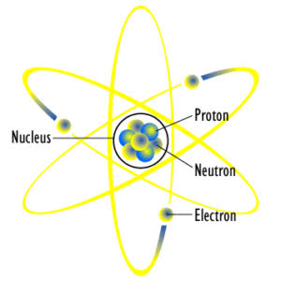
RADIATION BIOLOGY
ATOMIC STRUCTURE
Notes:
THE NUCLEUS IS COMPOSED OF MANY SUBATOMIC PARTICLES, BUT WE ARE ONLY CONCERNED WITH PROTONS(POSITIVELY CHARGED NUCLEONS) AND NEUTRONS (NO CHARGE); COLLECTIVELY CALLED NUCLEONS
THE CHARGE OF THE PROTON IS EQUAL TO BUT OPPPOSITE TO THAT OF THE ELECTRON IMMATERIAL OS THE SUBSTANCE. THE PROTO AND THE NEUTRON HAVE APPROXIMATELY THE SAME MASS WHICH IS ABOUT 1840 TIMES GREATER THAN THE MASS OF THE ELECTRON.

Slide 7
RADIATION BIOLOGY
The number of protons only in a nucleus is called the ATOMIC NUMBER (Z)
The atomic mass (A) is the total number of protons and neutrons in the nucleus of an atom.
When the number of protons equals the number of electrons that atom is known to be in a stable or neutral state.
The electrons in the orbit are maintained by the electrostatic force between the positively charged nucleus and the negatively charged electrons on the one hand, balanced by the centrifugal force of the revolving electrons.

Slide 8
ELECTROSTATIC FORCE
RADIATION BIOLOGY
It is the force of attraction between protons and electrons.

Slide 9
CENTRIFUGAL FORCE
RADIATION BIOLOGY
It is the force that pulls electrons away from the nucleus

Slide 10
RADIATION BIOLOGY
CF
EF
The balance between the electrostatic and the centrifugal forces keeps the electrons in orbit around the nucleus

Slide 11
IONIZATION
When the number of orbiting electrons in an atom is equal to the number of protons in the nucleus, the atom is electrically neutral.
If an electrically neutral atom loses an electron, it becomes a positive ion and the free electron is a negative ion. The process of forming an ion pair is called IONIZATION.

Slide 12
RADIATION BIOLOGY
How do X-rays cause damage ?

Slide 13
SEQUENCE OF EVENTS WHICH OCCUR WHEN AN X-RAY PHOTON STRIKES MATTER
RADIATION BIOLOGY
X- RAY PHOTON
MATTER
TRANSFER OF ENERGY TO THE ATOM
REMOVAL OF THE ELECTRON
IONIZATION OF THE ATOM
Coherent Scattering
Photoelectric Effect
Compton Scattering
Pass Through Unaffected

Slide 14
RADIATION BIOLOGY
WHAT IS IONIZATION?
Ionization – is a process where an atom or group of atoms loses one or more electrons

Slide 15
Radiation Causes Ionization of
RADIATION BIOLOGY
ATOMS
MOLECULES
CELLS
TISSUES
ORGANS
WHOLE BODY

Slide 16
RADIATION BIOLOGY
HISTORY
First recorded experiment in radiobiology - performed by Becquerel when he intentionally left a radium container in his vest pocket.
2 weeks later – erythema - ulceration - several weeks to heal
Pierre Curie – 1901 – repeated the experiment – radium burn on his forearm

Slide 17
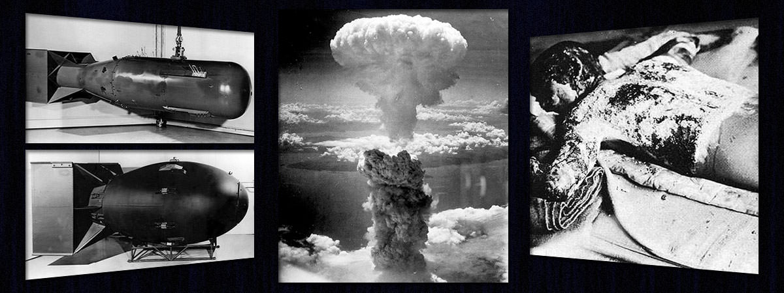
RADIATION BIOLOGY

Slide 18
RADIATION BIOLOGY
SOURCES OF RADIATION
Natural radiation(83%)- 3.1mSv/300mrem
Artificial radiation(17%)- 0.6mSv/60mrem
Radon 2 mSv(55%)
Cosmic 0.27 mSv (8%)
Rocks/soil 0.28 mSv (8%)
Food/water 0.4 mSv (11%)
Medical x-rays 0.39 mSv (11%)
Nuclear medicine 0.14 mSv (4%)
Consumer products 0.1 mSv (3%)
Other sources <0.01 mSv (<1%)

Slide 19
HOW MUCH AMOUNT OF RADIATION IS HARMFUL ??

Slide 20
RADIATION
INTERACT WITH MATTER : COMPTON PROCESS AND PHOTOELECTRIC PROCESS
PHOTONS INTERACTION WITH BIOLOGICAL MOLECULES
FREE RADICAL PRODUCTION
EFFECT

Slide 21
TYPES OF RADIATION EFFECTS
RADIATION BIOLOGY

Slide 22
- The initial interaction between ionizing radiation and matter occurs at the level of the electron within first 10⁻¹³ sec after exposure
RADIATION BIOLOGY
- The generation of free radicals occurs in less than 10⁻¹⁰ sec after the passage of a photon

Slide 23
RADIATION CHEMISTRY
RADIATION BIOLOGY
Ionizing radiation excites and ionized atoms of the absorbing tissue and the transfer of energy initiates chemical reaction which ultimately manifests as destruction of tissues.
At, cellular level, two distinct mechanisms are responsible for radiation injury or damage to the cells, i.e., direct effect and indirect effect.

Slide 24
INTERACTION OF RADIATION WITH BIOLOGICAL MOLECULES
RADIATION BIOLOGY
Direct or Target Action Theory (1/3rd)
Indirect Action or Poison Chemical Theory (2/3rd)

Slide 25
DIRECT OR TARGET ACTION THEORY
RADIATION BIOLOGY
Direct or Target Action Theory is that effect which occurs when the energy of a photon or secondary electron ionizes biological macromolecules.
This states that the changes occur due to:
• Absorption of energy by biological molecules.
• Transfer of energy between unstable intermediate molecules.
• Formation of stable damaged molecules by disassociation or cross-linking.
The resultant molecules differ structurally from the original molecule hence the consequence is a biological change in the irradiated organism

Slide 26
RADIATION BIOLOGY
Specific targets within the cell, probably the DNA or RNA in the nucleus take a direct hit from an incoming X-ray photon, or an ejected high energy electron, which breaks the relatively weak bonds between the nucleic acids.
The subsequent effect includes: • Inability to pass on information. • Abnormal replication. • Cell death. • Only temporary changes—the DNA being repaired successfully before further cell division.
If the radiation hits some somatic cells, the effects on the DNA could result in radiation induced malignancy.
If the damage is to reproductive stem cells, the result would be radiation-induced congenital abnormalities.

Slide 27
DIRECT ACTION
RADIATION BIOLOGY
When the energy of a photon or secondary electron ionizes biologic macromolecule, the effect is termed as DIRECT EFFECT.
When biologic molecule RH is ionized by radiation, direct alteration begins (where R is the molecule and H is hydrogen atom) with the absorption of energy by the biologic molecule and formation of unstable free radicals.
These free radicals are extremely reactive and transform into stable configuration by dissociation(breaking apart) or cross-linking(joining of two molecules)
FREE RADICAL PRODUCTION
RH + X-RADIATION = R. + H⁺ + e⁻
FATE OF FREE RADICAL
DISSOCIATION R = R. + H⁺ + e⁻

Slide 28
What actually happens depends on several factors
RADIATION BIOLOGY
The type and number of nucleic acid bonds that are broken
The intensity and type of radiation
The time between exposures
The ability of the cell to repair the damage

Slide 29
DIRECT ACTION
RADIATION BIOLOGY
A secondary electron resulting from absorption of an x-ray photon interacts with DNA directly by breaking the relatively weak bonds between nucleic acids to produce the effect
RH + x-radiation →R. + H+ + e
R. → X + Y.
R. + S. →RS
Results in altered molecule that differs structurally and functionally from the original molecule

Slide 30
INDIRECT ACTION THEORY OR POISON CHEMICAL THEORY
RADIATION BIOLOGY
Water is a predominant molecule of the biological system
When the photon is absorbed by the water molecule, it is ionized and releases free radicals which further interact and produce changes in the biologic molecule, this effect is termed ‘indirect’

Slide 31
INDIRECT ACTION
RADIATION BIOLOGY

Slide 32
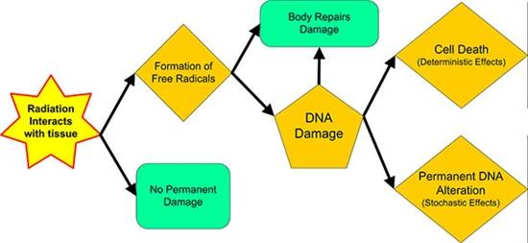
RADIATION BIOLOGY

Slide 33
RADIATION BIOLOGY
CONTRIBUTION OF
DIRECT AND INDIRECT EFFECTS
DIRECT EFFECT – 30 – 40%
INDIRECT EFFECT - 60 – 70%
Sparsely ionizing radiations such as x-rays or gamma- rays induce damage mainly through indirect effect while densely ionizing radiations such as neutrons and alpha particles cause damage primarily through direct effect
Indirect effects can be altered with use of radioprotectors during radiotherapy while direct cannot

Slide 34
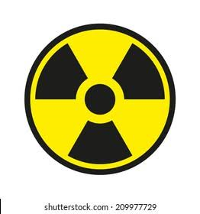
RADIATION BIOLOGY Part - 2
Department
of
Oral Medicine and Radiology
Dr. Pratima Soni

Slide 35
CONTENTS
Effect of radiation on biological molecules
Radio-sensitivity of cells
Effect of radiation on the biological tissues
Factors modifying effect of radiation
Effects of therapeutic radiation on oral tissues

Slide 36
EFFECT OF RADIATION ON BIOLOGICAL MOLECULES
RADIATION BIOLOGY
NUCLEIC ACIDS
Different types of alterations occur in DNA.
MOST COMMON –
Breakage of one or both strands of DNA
Cross- linking of DNA strands within the helix to other DNA strands or to proteins
Change or loss of base
Disruption of hydrogen bonds between the DNA Strands

Slide 37
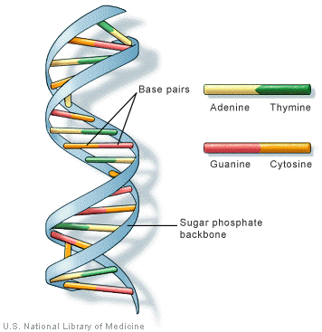
RADIATION BIOLOGY
BREAKAGE OF DNA
SINGLE STRANDED BREAKAGE
1. Little biological significance.
2. As damage is repaired by using intact second strand.
DOUBLE STRANDED BREAKAGE
1. Both the strands of DNA are damaged at the same location or within the free base pair.
2. Repair is complicated as there is lack of intact template.

Slide 38
RADIATION BIOLOGY
PROTEINS
Irradiation of proteins leads to
Changes in their secondary and tertiary structure by disruption of side chains
Breakage of hydrogen or disulphide bonds
Denaturation of proteins
Inter and intra-molecular cross-linking
The dose required to induce a significant amount of protein denaturation is much higher than that required for cell death

Slide 39
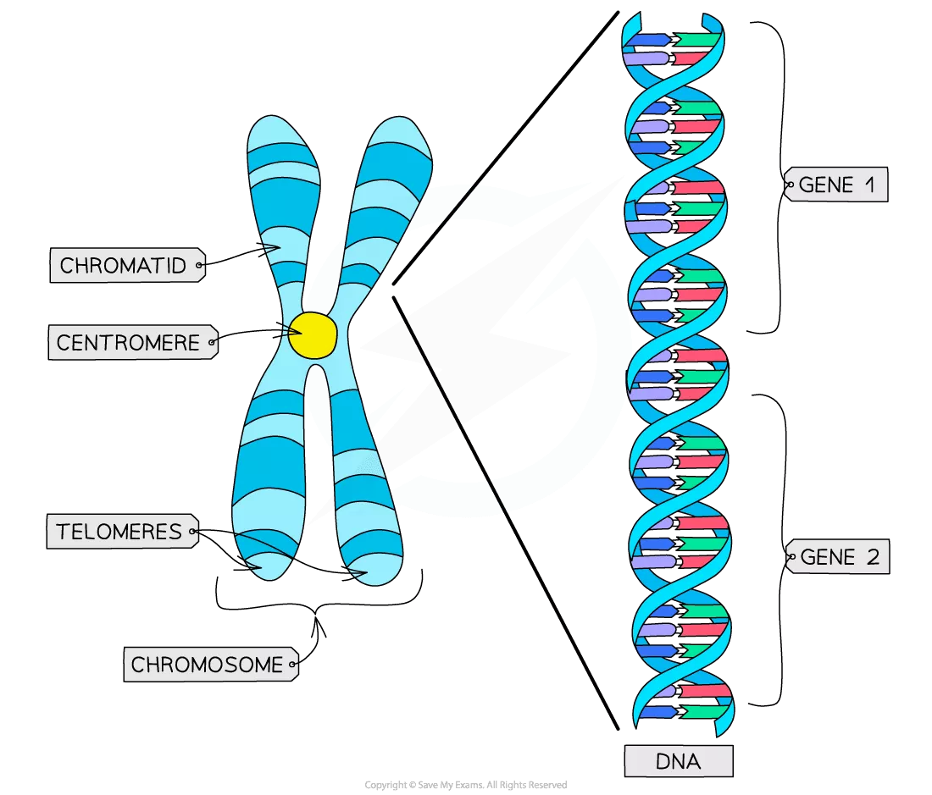
RADIATION BIOLOGY
CHROMOSOME

Slide 40
CHROMOSOME
RADIATION BIOLOGY
Chromosome aberrations – irradiated early in interphase, before the chromosome material has duplicated – break in both chromatids strands
Chromatid aberrations – irradiated later in interphase, after DNA material has doubled – break seen in one chromatid strand

Slide 41
Ring
Deletion
Dicentric
Symmetric translocation
Two important
t y p e s o f chromosomal changes that are not lethal to the cell are s y m m e t r i c translocations & s m a l l deletions

Slide 42
RADIATION BIOLOGY
CYTOPLASM
Mitochondria demonstrate
increased permeability, swelling and disorganization of the internal cristae.

Slide 43
EFFECTS ON CELL KINETICS
RADIATION BIOLOGY

Slide 44
CELL CYCLE CHECK POINTS
RADIATION BIOLOGY
-To prevent defective DNA cycle
progression of through cell
- two check points – G1S and G2M

Slide 45
CELL CYCLE CHECK POINTS
RADIATION BIOLOGY
CHECK POINT
G 1 - S POINT C H E C K | Before a cell makes the final commitment to replicate, the G₁/S check point checks for DNA damage
 | if damage is present, the DNA-repair machinery and mechanisms that arrest the cell cycle The delay in cell cycle progression provides the time needed for DNA repair; if the damage is not repairable, apoptotic pathways are activated to kill the cell.

Slide 46
G 2 - M POINT
RADIATION BIOLOGY
C H E C K -The G₂/M checkpoint monitors the completion
of DNA replication and checks whether the cell can safely initiate mitosis and separate sister chromatids.
This checkpoint is particularly important in cells exposed to ionizing radiation.
Cells damaged by ionizing radiation activate the G₂/M checkpoint and arrest in G₂; defects in
this checkpoint give rise to chromosomal abnormalities

Slide 47
EFFECTS ON CELL KINETICS
RADIATION BIOLOGY
Mitotic delay
Recovery
Cell death

Slide 48
RADIATION BIOLOGY
MITOTIC DELAY
Radiation affects the expression of both cyclins and cyclin dependent kinases
Delay in cellular progression through cell division

Slide 49
RADIATION BIOLOGY
MITOTIC DELAY
Low dose: Mild delay in G2 phase. Moderate dose: G2 block.
Larger doses: Incomplete recovery

Slide 50
EFFECTS ON CELL KINETICS
RADIATION BIOLOGY
Mitotic delay
Recovery
Cell death

Slide 51
RECOVERY
RADIATION BIOLOGY
Enzymatic repair of single-stranded breaks of DNA
Damage to both strands: lethal to cell.

Slide 52
EFFECTS ON CELL KINETICS
RADIATION BIOLOGY
Mitotic delay
Recovery
Cell death
Mitotic death
Apoptosis

Slide 53
1. MITOTIC DEATH
RADIATION BIOLOGY
Also called reproductive death
dominant mode of cell killing
cell dies when they attempt to divide
double strand breakage in DNA frequent cause of cell death
Mean lethal dose for loss of proliferative capacity - 2Gy

Slide 54
2. APOPTOSIS
RADIATION BIOLOGY
Typically observe after low radiation dose
occurs within hours after radiation exposure
seen in lymphomas , serous cells of salivary glands
lead to rapid onset xerostomia after moderate dose of radiations

Slide 55
RADIOSENSTIVITY OF CELLS
RADIATION BIOLOGY

Slide 56
RADIATION BIOLOGY
Different cells from various organs of the same individual may respond to irradiation quite differently
This variation was recognized as early as 1906 by the French radiobiologists and is called
“Law of Bergonie and Tribondeau”
“Radiation is more effective against cells that are actively dividing, are undifferentiated and have large dividing future”

Slide 57
RADIATION BIOLOGY
They observed that the most radiosensitive cells are those that
Have a high mitotic rate
Undergo many future mitoses
Are most primitive in differentiation
Lymphocytes and oocytes: exceptional

Slide 58
Vegetative intermitotic cells | -Most radiosensitive -Primitive in differentiation -High mitotic rate -E.g. cells of spermatogenic and erythroblastic series, basal cells of oral mucous membrane.
Differentiating intermitotic cells | -Less radiosensitive than vegetative cells -Divide regularly -Undergo some differentiation between divisions -E.g. inner enamel epithelium of developing teeth, cells of haematopoietic series, spermatocytes and oocytes.

Slide 59
Multi potential connective tissue cells | -Have intermediate sensitivity -Divide when there is demand for more cells -E.g.endothelial cells, fibroblasts, mesenchymal cells
Reverting post mitotic cells | -Radio resistant because they divide infrequently - e.g. acinar, ductal, parenchymal cells of glands.
Fixed post mitotic cells | -Most resistant -- highly differentiated cells --incapable of division -- e.g. neurons, striated muscle cells, epithelial cells, erythrocytes.

Slide 60
RADIATION BIOLOGY
RADIATION
INTERACT WITH MATTER : COMPTON PROCESS AND PHOTOELECTRIC PROCESS
PHOTONS INTERACTION WITH BIOLOGICAL MOLECULES
FREE RADICAL PRODUCTION
EFFECT

Slide 61
EFFECT OF RADIATION ON THE BIOLOGICAL TISSUES
RADIATION BIOLOGY

Slide 62
BIOLOGIC EFFECTS OF RADIATION
RADIATION BIOLOGY

Slide 63
CLASSIFICATION OF BIOLOGIC EFFECTS OF RADIATION
RADIATION BIOLOGY
Somatic & Genetic Effects
Stochastic & Deterministic Effects
Short - term & Long - term Effects

Slide 64
1. Somatic vs. Genetic Effects
RADIATION BIOLOGY
 | Definition | Effects | Examples
Somatic | Harm to person exposed to the radiation | Acute — large dose of radiation absorbed in a short time | - Leukemia
 |  | Chronic — small amt of radiations absorbed repeatedly over long time (latent period ≥20 yrs)
Genetic | Harm to person in future generation due to ancestor’s exposure | Radiation to reproductive organs damage the DNA of sperms or eggs No threshold dose | - Congenital abnormality

Slide 65
2. Stochastic vs. Deterministic Effects
RADIATION BIOLOGY

Slide 66
2. Stochastic vs. Deterministic Effects
RADIATION BIOLOGY
 | Traits | Effects | Example
Stochastic | “all or none” response; any dose can cause | No threshold dose Every exposure to ionizing radiation carries with it the possibility of inducing a stochastic effect. | ⬆ Incidence of leukaemia & certain tumours
Deterministi c (non stochastic) | “certainty effects”; severity of effect ⬆ with ⬆ dose; | Threshold dose exists below which there will be no effect. | Erythema: all will experience once minimum dose is given; gets worse with ⬆dose

Slide 67
3. Short - term vs. Long - term Effects
RADIATION BIOLOGY
 | Traits | Example
Short term effects | Determined primarily by sensitivity of its parenchymal cells | Bone marrow, oral mucosa - high radiosensitive - mitosis-linked cell death. Muscle - low radiosensitive
Long term effects | Depend primarily on extent of damage to fine vasculature | Progressive fibroatrophy of the irradiated tissue

Slide 68
FACTORS MODIFYING EFFECT OF RADIATION
RADIATION BIOLOGY

Slide 69
RADIATION BIOLOGY
DOSE
DOSE RATE
High dose rate causes more damage than exposure to the same total dose given at a lower dose rate
When organisms are exposed at lower dose rates, a greater opportunity exists for repair of damage, thereby resulting in less net damage
OXYGEN
Presence of oxygen alters how cells process free radicals
In presence of oxygen free radicals lead to irreparable lethal changes
The severity of deterministic damage seen in irradiated tissues or organs depends on the amount of radiation received
All individuals receiving doses above the threshold level show damage in proportion to the dose

Slide 70
RADIATION BIOLOGY
OXYGEN ENHANCEMENT RATIO
Magnitude of the effect of oxygen on radiosensitivity
Ratio of hypoxic to aerated cells to achieve the same biologic effect.
Sparsely ionizing radiation: 2.5-3

Slide 71
CELL AGE IN DIVISION CYCLE
RADIATION BIOLOGY
Cells in late G2 – most radiosensitive
S phase – radioresistant
Late G1 and early S- intermediate sensitivity

Slide 72
LINEAR ENERGY TRANSFER
RADIATION BIOLOGY
Higher-LET radiations (α particles) are more efficient in damaging biologic systems because their high ionization density is more likely than x rays to induce double strand breakage in DNA

Slide 73
RADIATION BIOLOGY Part - 3
Department
of
Oral Medicine and Radiology
Dr. Pratima Soni

Slide 74
CONTENTS
RADIATION BIOLOGY
RATIONALE OF RADIOTHERAPY IN THE ORAL CAVITY
EFFECT OF THERAPEUTIC RADIATION ON ORAL TISSUES
DETERMINISTIC EFFECTS OF WHOLE BODY RADIATION
Acute radiation syndrome
Radiation effects on embryos and fetuses
Late effects
STOCHASTIC EFFECTS
Carcinogenesis
Heritable effects

Slide 75
RATIONALE OF RADIOTHERAPY
RADIATION BIOLOGY
Radiosensitive lesion,
Advanced or deeply invasive,
Cannot be approached surgically
Chemotherapy + Radiotherapy + Surgery
Fractionation

Slide 76
COURSE OF RADIOTHERAPY IN ORAL CANCERS
RADIATION BIOLOGY
2 Gy is delivered daily for a total weekly exposure of 10 Gy
Course continues for 6 – 7 weeks and a total of 60 to 70 Gy is administered
Recently introduced
IGRT – Intensity guided RT
IMRT – Intensity Modulated RT

Slide 77
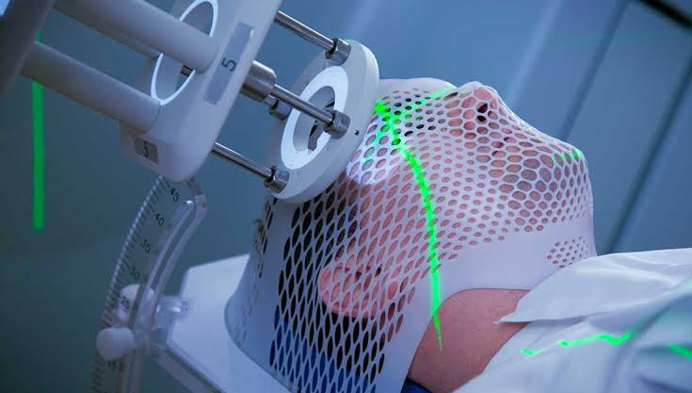
EFFECTS OF THERAPEUTIC RADIATION ON ORAL TISSUES
RADIATION BIOLOGY

Slide 78
RADIATION BIOLOGY
Oral Mucous Membrane
Salivary Glands
Taste buds
Teeth
Bone

Slide 79
Oral Mucous Membrane
RADIATION BIOLOGY
Oral mucosa contains basal layer composed of rapidly dividing, radiosensitive stem cells
Appearance of white to yellow pseudo-membrane
At the end of therapy, mucositis is most severe
ORAL MUCOSITIS
HEALING
HEALING

Slide 81
PATHOPHYSIOLOGY OF ORAL MUCOSITIS
CELL EXPOSURE TO RADIOTHERAPY
GENERATION OF REACTIVE OXYGEN SPECIES
STIMULATE TRANSCRIPTION FACTORS
DNA DAMAGE
TISSUE INJURY
CELLULAR PROLIFERTION
CYTOKINES
INGRESS OF BACTERIA, VIRUS, FUNGI
ULCERATION
TISSUE HEALING

Slide 82
SALIVARY GLANDS
RADIATION BIOLOGY
Parotid gland $>$Submandibular/ sublingual
Parotid gland > Submandibular/ sublingual
Months after RT inflammatory response is chronic and the glands demonstrate marked loss of acini and progressive fibrosis
Serous cells $>$ Mucous cells
Serous cells > Mucous cells
pH decreases
Buffering capacity decreases
MANAGEMENT
Frequent sips of water, sugarless chewing gum,
Pilocarpine hydrochloride (5mg – 4 times a day)

Slide 83
EFFECT ON TASTE BUDS
RADIATION BIOLOGY
Partial or complete loss of taste if taste buds are irradiated
Irradiation of posterior tongue → loss of bitter and acid flavours
Irradiation of anterior tongue → loss of sweet and salt flavours
Generally cells regenerate in 60 to 120 days
Management
Dietary consultation-improve quality of food
Zinc sulphate capsules- 220mg twice daily with food,
elemental zinc- 100mg

Slide 84
RADIATION EFFECT ON TEETH
RADIATION BIOLOGY
Before calcification: Destroys tooth bud
After calcification : inhibits cellular differentiation →malformation and arrested growth
During development: Retards growth
Eruptive Mechanism: Radio-resistant
In adults : No effect on calcified tissue
Pulp: Fibroatrophy

Slide 85
RADIATION CARIES
RADIATION BIOLOGY
Rampant form of dental decay
Result from changes in the salivary glands and saliva, including reduced flow, decreased pH, reduced buffering capacity, and increased viscosity
Because of the reduced or absent cleansing action of normal saliva, debris accumulates quickly
Irradiation of the teeth by itself does not influence the course of radiation caries

Slide 86
RADIATION BIOLOGY
Clinically, three types of radiation caries exist
The most common is widespread superficial lesions attacking buccal, occlusal, incisal, and palatal surfaces

Slide 87
RADIATION BIOLOGY
Another type involves primarily the cementum & dentin in the cervical region
These lesions may progress around the teeth circumferentially and result in loss of the crown

Slide 88
RADIATION BIOLOGY
A final type appears as a dark pigmentation of the entire crown
The incisal edges may be markedly worn
Management
Hydrogen peroxide rinses 3% (maintenance of oral hygiene)
Topical fluoride applications

Slide 89
MUSCLES & JOINTS
RADIATION BIOLOGY
may develop due to tumor invasion of the masticatory muscles and/or the TMJ
the result of radiotherapy if masticatory muscles and/or the TMJ is included in the field of radiation, or a combination of both
TRISMUS
Trismus develops 3-6 months after radiation treatment is completed and frequently becomes a lifelong problem

Slide 90
RADIATION BIOLOGY
Ichimura and Tanaka, 1993
Trismus is attributed to muscle fibrosis and scarring in response to radiation injury as well as to fibrosis of the ligaments around the TMJ and scarring of the pterygomandibular raphe.

Slide 91
OSTEORADIONECROSIS
RADIATION BIOLOGY
-Also known as post radiation osteonecrosis
- First described by – Regaud in 1920
A serious deforming, debilitating complication of radiation therapy

Slide 92
RADIATION BIOLOGY
PATHOPHYSIOLOGY:
1. Meyer in 1970:
triad of radiation , trauma and infection
Irradiated bone
traumatic event
→ ingress of micro- organisms
→ Osteoradionecrosis
Notes:
Failure :
Failure to demonstrate bacterial invasion in compromised bone
ORN can occur without any definable traumatic event
poor response to treatment with antibiotic therapy

Slide 93
PATHOPHYSIOLOGY
RADIATION BIOLOGY
2. Marx in 1983- “three H principle”
- Cumulative tissue damage induced by radiation rather than trauma or bacterial invasion
Hypo-cellular
Hypo-vascular and
Hypoxic tissue

Slide 94
RADIATION BIOLOGY
3. Fibroatrophic theory :
Introduced in 2004
Key event in progression of
ORN is activation and
dysregulation of fibroblastic activity → atrophic tissue

Slide 95
RADIATION BIOLOGY

Slide 96
RADIATION BIOLOGY
Three distinct phases :
1. Prefibrotic phase : acute inflammatory response →
in endothelial cells
changes
Constitutive organized phase : abnormal fibroblastic activity
→ disorganization of ECM
Late fibroatrophic phase: attempted tissue remodelling
→fragile tissue ; carries inherent risk of reactivation of inflammation secondary to local trauma

Slide 97
CLINICAL FEATURES
RADIATION BIOLOGY
In head and neck region commonest site is mandible > maxilla> temporal bone > sphenoid bone> base of skull
Signs and symptoms:
- Pain
- Swelling
- Trismus
- Halitosis
Exposed bone
Pathological fracture
Oro- cutaneous fistula

Slide 98
RADIATION BIOLOGY

Slide 99
RADIATION BIOLOGY
IMAGING STUDIES:
- Early changes : areas of decalcification
- Late changes : formation of sequestrum and involucrum

Slide 100
RADIATION BIOLOGY
PREVENTION OF ORN:
-Recommendations given by Sleeper and Meyer
Mouth should be made as clean as possible with scaling and irrigation
All infections should be eliminated
All infected and non vital teeth should be extracted
All periodontally compromised teeth should be extracted
All teeth in line of irradiation (good or bad)

Slide 101
MANAGEMENT OF OSTEORADIONECROSIS:
RADIATION BIOLOGY
- Control of infection if present
Remove debris and gentle irrigation
Supportive treatment with fluids + diet high in protein\
Pain management – Narcotic analgesics, Nerve Blocks
Hyperbaric oxygen therapy

Slide 102
HYPERBARIC OXYGEN THERAPY :
RADIATION BIOLOGY
-Consist of exposing a patient to intermittent short term 100% oxygen inhalation at a pressure greater than 1 atmosphere
HBO → induce endothelial cell neovascularization
Contraindications:
-Untreated pneumothorax
pregnancy
emphysema
URTI, optic neuritis , ear problems
proliferation →

Slide 103
DETERMINISTIC EFFECTS OF WHOLE BODY RADIATION
RADIATION BIOLOGY
ACUTE RADIATION SYNDROME
LATE EFFECTS / CHRONIC

Slide 104
ACUTE RADIATION SYNDROME
The acute radiation syndrome is a collection of signs and symptoms experienced by individuals after a brief whole-body exposure to radiation
DOSE IN Gy | MANIFESTATIONS
1-2 | Prodromal symptoms
2-4 | Mild hematopoietic symptoms
4-7 | Severe hematopoietic symptoms
7-15 | Gastrointestinal symptoms
>50 | Cardiovascular and CNS symptoms

Slide 105
ACUTE RADIATION SYNDROME
Prodromal symptoms
Minutes to hours after exposure
Anorexia, nausea, vomiting, diarrhea, fatigue and weakness
Higher the dose , the more rapid the onset and greater will be severity of symptoms
Latent period
Lasting hours or days after supra-lethal exposures (approx. > 5 Gy) to few weeks after exposure of about 2 Gy

Slide 106
HEMATOPOIETIC SYNDROME
Radiation causes damage to hematopoietic cells of bone marrow & spleen
Remarkable fall in the no. of granulocytes, platelets and erythrocytes
Clinical signs: Infection, hemorrhage & anemia
Death may occur 10 to 30 days after radiation
Management: removal of sources of infection, antibiotics and bone marrow transplantation

Slide 107
GASTROINTESTINAL SYNDROME
Rapidly proliferating basal epithelial cells of the intestinal villi are damaged
Loss of epithelial layer of the intestinal mucosa →loss of plasma & electrolytes
Reduced efficiency of intestinal absorption
Ulceration and hemorrhage in the intestines
Bacteria invade denuded areas→ septicemia, diarrhea, dehydration, loss of weight
Death occurs within 2 weeks : combination of fluid and electrolyte loss, infection and nutritional impairement

Slide 108
CVS and CNS SYNDROME
Irreversible condition
> 50 Gy causes death in 1- 2 days
Circulatory system collapses, drastic fall in BP
Incoordination, disorientation, and convulsions

Slide 109
LATE DETERMINISTIC EFFECTS OF WHOLE BODY RADIATION
RADIATION BIOLOGY

Slide 110
RADIATION BIOLOGY
Growth & development
Height
Cataracts
Shortened life span
Increased frequency of heart disease, stroke and non cancer diseases
Weight
Skeletal development

Slide 111
SOMATIC EFFECTS OF RADIATION
RADIATION BIOLOGY
CARCINOGENESIS
HERITABLE EFFECTS

Slide 112
RADIATION BIOLOGY
CARCINOGENESIS
Radiation leads to modification of biologic molecules
Molecular changes may lead to alteration in cells and organisms
If enough cells are killed --- injury or death
If cells are modified --- cancer

Slide 113
RADIATION BIOLOGY
Radiation induced cancers are indistinguishable from cancers produced by other causes
Risk is greater in childhood
Risk of leukemia is higher than solid tumors ; higher rate of cell division and differentiation of hematopoietic stem cells

Slide 114
Susceptibility of different organs to radiation induced cancer
RADIATION BIOLOGY
High
Intermediate
Low
Colon
Stomach
Lung
Bone marrow (Leukemia)
Breast (women)
- Bladder
- Liver
- Thyroid
Skin
Bone surface
Brain
Salivary glands

Slide 115
EFFECT ON GROWTH AND DEVELOPMENT
children exposed to radiation → reduced height, weight, skeletal development
developing human brain is radiosensitive : in utero exposure → mental retardation (4% chance of mental retardation per 100mSv at 8 to 15 weeks of gestation)

Slide 116
EFFECTS ON FETUS & UTERUS
Preimplantation:
dose of 1 to 3Gy →
Organogenesis:
death of embryo
congenital anomalies
The fetal period:
Largest degree of growth retardation.

Slide 117
HERITABLE EFFECTS
RADIATION BIOLOGY
Changes seen in off-springs of irradiated individuals
Our knowledge of heritable effects of radiation comes from the atomic bomb survivors.

Slide 118
CONCLUSION

Slide 119
QUESTIONS

Slide 120
RADIATION BIOLOGY
QUESTION 1
First complication after Radiotherapy is ??
Candidiasis
Alopecia
Mucositis
Xerostomia

Slide 121
RADIATION BIOLOGY
QUESTION 2
Radiation caries occurs due to all of the following except??
Bone defects
Fibrosis of salivary glands
Decreased flow of saliva
Low pH of saliva

Slide 122
RADIATION BIOLOGY
QUESTION 3
Months or years following radiotherapy the irradiated oral mucosa??
Undergoes necrosis
Becomes atrophic
Develops candidiasis
Develops granulomatosis

Slide 123
RADIATION BIOLOGY
QUESTION 4
Deterministic effects of radiation are those effects in which the severity of response is
Proportional to the dose
Is determined by the operator
Depends on composition of the tissues
Depends on volume of exposed tissue

Slide 124
RADIATION BIOLOGY
QUESTION 5
Which layer of epithelium of oral mucous membrane is more sensitive to radiation ?
Stratum spinosum
Stratum granulosum
Stratum corneum
Stratum basale

Slide 125
THANK YOU

Slide 127
Normal cell
SUCCESSFUL DNA REPAIR
DNA Damage
Failure of DNA repair
Mutations in the genome of somatic cell
ACTIVATION OF GROWTH PROMOTING GENES
INACTIVATION OF TUMOR SUPRESSOR GENES
ALTERATION IN GENES THAT REGULATE APOPTOSIS
Unregulated cell proliferation
Decreased apoptosis
ANGIOGENESIS
Clonal expansion
ESCAPE FROM IMMUNITY
ADDITIONAL MUTATIONS
Tumor progression
Malignant neoplasm
Invasion and metastasis

Slide 128
General effects of radiation
Skin –
Early or acute signs
Increased susceptibility to chapping
Intolerance to surgical scrub
Blunting & leveling of finger ridges
Brittleness & ridging of finger nails
Late or chronic signs
Loss of hair
Dryness & atrophy of skin – sweat glands destroyed
Pigmentations, telangiectasis, keratosis
Indolent type of ulcerations
Possibility of malignant changes in tissue

Slide 129
Hematopoietic injury – leucopenia, which in some cases may progress to leukemia, anemia, lymphopenia
Eyes
▪
▪
Epilation of eyelashes
Inflammation, fibrosis, & decreased flexibility of eye lids
Dryness
Ulceration & cataract
▪
▪

Slide 130
Ears
edema of mucosa & collection of fluid causing obstruction of Eustachian tube – Radiation Otitis Media
Deafness due to rupture of ear drum
Testicles
▪
▪
Suppression of germinal activity Alteration in fertility

Slide 131
7. Oral mucous membrane
▪
▪
▪
▪
▪
▪
Reddening & inflammation (mucositis) Sloughing & pseudomembrane formation Secondary infection
Obliteration of vasculature Fibrosis of underlying C/T
Oral ulcerations

Slide 132
Taste buds – alterations in taste
Salivary glands – parenchymal component affected – fibrosis, adiposis, loss of fine vasculature.
▪
▪
▪
▪
▪
▪
Xerostomia
Composition of saliva altered Increased Na, Cl, Ca, Mg & proteins
Loses lubricating property
PH decreases – decalcification of enamel Compensatory gland hypertrophy

Slide 133
10. Teeth
▪
▪
▪
Adult teeth are resistant to radiation Prior to calcification tooth buds destroy During calcification defect in cellular
differentiation - ↓sed vascularity, cellularity of pulp & prone to pulpitis
Radiation caries
▪

Slide 134
11. Bone
Loss of vasculature & hematopoietic elements
Marrow replaced by fatty marrow & fibrous connective tissue
Lack of osteoblasts & osteoblastic activity Osteoradionecrosis following radiation
▪
▪
▪

Slide 135
DOUBLING DOSE
The amount of radiation a population requires to produce in the next generation as many additional mutation as arise spontaneously
In humans : approx 2Gy

Slide 136
CLINICAL APPLICATIONS

Slide 137
RATIONALE OF FRACTIONATION IN RADIOTHERAPY
Provides greater tumour destruction than is possible with a large single dose
Increased cellular repair of normal tissue
Increases the mean oxygen tension in an irradiated tumour

Slide 138
4 R’s of Radiobiology
Repair of sublethal damage in normal cells
Reassortment of cells within the cell cycle
Repopulation of normal cells
Reoxygenation of tumour bed

Slide 139
BIOLOGIC BASIS OF DOSE FRACTIONATION
1. REPAIR OF SUBLETHAL DAMAGE:
Reflects the ability of cells to recover from damage that does not cause lethality
Repair capacity is greater in late responding tissues
decreasing the dose per fraction will result in greater sparing of late responding tissues

Slide 140
Cell survival curve
Curve describes the relationship between the radiation dose & the proportion of cells that survive
Mean lethal dose kills on average 63% of cells
Accumulation of sublethal damage
Each additional dose reduces cell survival to 37% of the previous level

Slide 141
2. REDISTRIBUTION:
First radiation dose preferentially kills cells in the sensitive phases
cells surviving the first dose will resume their progression through cell cycle into more radiosensitive phases
Resulting in net sensitization to the next dose fraction
redistribution results in net gain in therapeutic ratio

Slide 142
3. REGENERATION :
- Depletion of cells following radiation or surgery
triggers a
regenerative response , resulting in net increase in cell production
- decrease normal tissue injury

Slide 143
4. REOXYGENATION :
Hypoxic cells are radioresistant
Preferential elimination of more radiosensitive oxygenated cells increases oxygen availability to surviving hypoxic cells
increase tissue sensitivity to radiation

Slide 144
According to standard therapeutic regimen : Dose of 200cGY is delivered ; 5 days a week for 5-6 weeks with total dosage of 50-60 Gy

Slide 145
ALTERED FRACTIONATION SCHEMES
1. HYPERFRACTIONATION :
Smaller fraction size ( 115-120cGy)
Two to three times in a day
total dosage is larger ( 74-80Gy)
treatment duration is same Advantages : improve therapeutic ratio
Redistribution of tumor cells into more radiosensitive phases due to multiple fractions
differential sparing of late responding normal tissue

Slide 146
ALTERED FRACTIONATION SCHEMES
2. ACCELERATED FRACTIONATION :
Same fraction size ( 180-200cGy)
Two to three times in a day
total dosage is similar
treatment duration is short Advantages :
reduce the opportunity for accelerated repopulation of cells

Slide 147
ALTERED FRACTIONATION SCHEMES
3. HYPOFRACTIONATION :
Larger fraction size ( 600-800cGy)
Fractions delivered with gap of several days
total dosage is lower (2100-3200cGy)
treatment duration is short Advantages :
Evolved for the treatment of malignant melanoma ( conventional fractions allow tumor cells to recover between fraction intervals , high dose per fraction will overcome the reparative capacity of tumor cells

Slide 148
RADIOSENSITIZATION
Target at
Reducing hypoxia
Concomitant chemotherapy
Targeted therapy

Slide 149
RADIOSENSITIZATION
REDUCING HYPOXIA
Correction of anemia
Infusion of erythropoietin
Hyperbaric oxygen therapy CONCOMITANT CHEMOTHERAPY
Decrease micrometastasis
Kill hypoxic cells ( mitomycin active in hypoxic condition )
Kills radioresistant cells in S phase of cell cycle

Slide 150
RADIOPROTECTORS
Agents that when present prior to or shortly after radiation exposure alter the response of normal tissues to irradiation.
- Sulfhydryl compounds such as cysteine and cysteamine have long been known to act as radioprotectors via free radical scavenging → Alter the indirect effect of radiation → protection of normal tissue

Slide 151
SUMMARY
The toxic biological effects of ionizing radiation, although complex, varied,and incompletely understood, form the basis for the use of radiation therapy as a cancer treatment. These biological effects are initiated when packets of energy are deposited in a volume of tissue and remove electrons from constituent atoms through a process called ionization. Accordingly, the physics of radiation oncology is focused on the details of how, where, and how much energy can be deposited in diseased tissue in the hopes of eradicating it, while simultaneously minimizing the energy released in healthy tissue. This process requires an understanding of the nature of the radiation and the matter through which it passes and how that matter is changed as a result of the energy deposition events.

Slide 152
REFERENCES
Oral radiology, principles & interpretation: white & pharoah
Essentials of dental radiography & radiology: whaites
Oral sequelae of head & neck radiotherapy: crit rev oral biol med 2003
Prevention & treatment of the consequences of head & neck radiotherapy: crit rev oral biol med 2003
Dental management of the oncologic patient: DCNA 2008
Protocol for the prevention and treatment of oral sequelae resulting from head and neck radiation therapy: cancer 1992

Slide 153
THANKYOU

