Slide 1
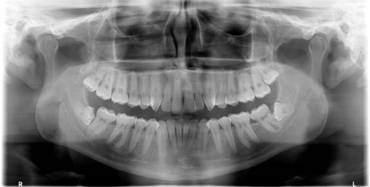
ORTHOPANTOMOGRAPHY
Notes:
PANORAMIC AND INTRAORAL RADIOGRAPHS AARE THE BASIC IMAGING MODALITIES USED IN DENTISTRY.OFTEN THEY ARE THE ONLY IMAGING TECHNIQUES USED TO DELIEANTE ANATOMY AND PATHOLOGY. AND HENCE IT IS IMPROTANT TO KNOW THE WORKING ,TECHNICAL ASPECTS NA DTHE CONCEPTS BEHIND THIS OPG

Slide 2
CONTENT
Introduction
History
Principle
Parts of machine
Indications
Contraindication
Advantages
Disadvantages
Preparation of patient
Normal Anatomical Landmarks
Faulty Radiographs
Conclusion

Slide 3
‘Panorama’
‘Tomography’
PANTOMOGRAPHY
An unobstructed view of a region in every direction
An X-ray technique for making radiographs of layers of tissue in depth without the interference of tissues above and below the level
Notes:
Tpantomography is derived 4m 2 words – panorama and tomography

Slide 4
INTRODUCTION
Conventional tomography is a specialized radiographic technique developed originally for producing radiographs that showed only a section or slices of a patient.
Each individual tomographic image shows the tissues within that section sharply defined and in focus. The section is thus referred to as the focal plane or focal trough.
Panoramic imaging (also called pantomography) is a technique for producing a single tomographic image of the facial structures that includes both the maxillary and mandibular dental arches and their supporting structures.
Notes:
This is a curvilinear
variant of conventional tomography and is also based on the principle
The movement of the film and the tube head produces an image through the process known as tomography, the term tomo means section
of the reciprocal movement of an x-ray source and an image receptor
around a central point or plane, called the image layer, in which the
object of interest is located.

Slide 5
Production of each conventional tomographic slice requires controlled, accurate movement of both x- ray tube head and film.
By varying the size of beam and type of equipment, it proved possible to change the shape of tomographic layer.

Slide 6
HISTORY
H. NUMATA(Japan) constructed a device suitable for clinical examinations, calling the method “parabolic radiography” and published his first results in 1933
Paatero and, independently, Numata were the first to describe the principles of panoramic radiography.
PAATERO introduced the terms “pantomography” (panoramic tomography) and, later, “orthopantomography” (orthoradial panoramic tomography).
History of panoramic radiography. Dorrit Hallikainen. Acta Radiologica 37 (1996) 441445

Slide 7
PANORAMIC MACHINES

Slide 8
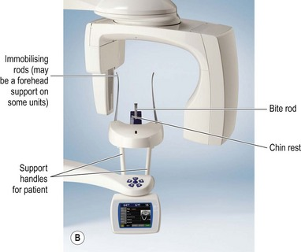
COMPONENTS OF OPG MACHINE
X- ray tube head
Control panel
Patient- positioning apparatus
Image receptors

Slide 9
Digital Image Receptors
Solid-state
technology
Photostimulable phosphor technology
CCD
CMOS
FPD

Slide 10
WORKING OF OPG MACHINE

Slide 12
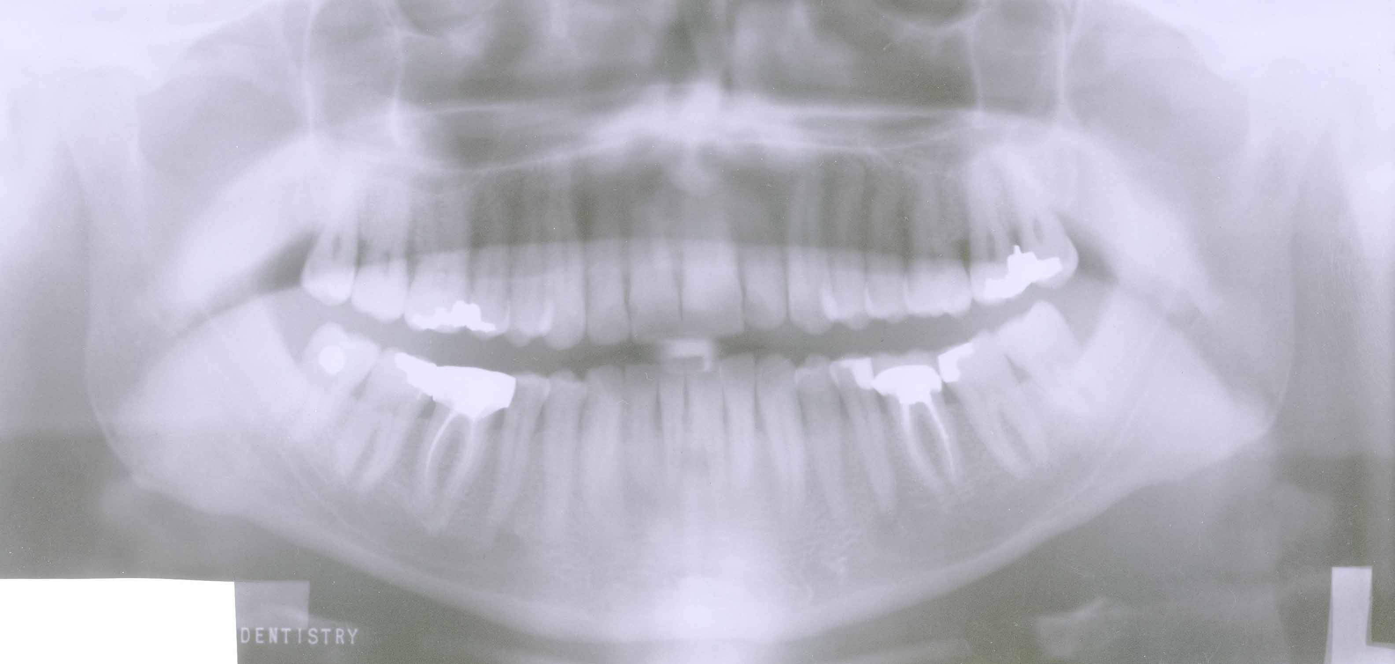
0
Notes:
Next is the working of panoramic radiography
As the tubehead rotates around the patient, the x-ray beam passes through different parts of the jaws, producing multiple images that appear as one continuous image on the film (“panoramic view”).
When you click the mouse, the tubehead will rotate around the patient and produce the images. The red dots represent the sliding rotation center.
Click the mouse to align and merge these individual images into one continuous image.

Slide 13
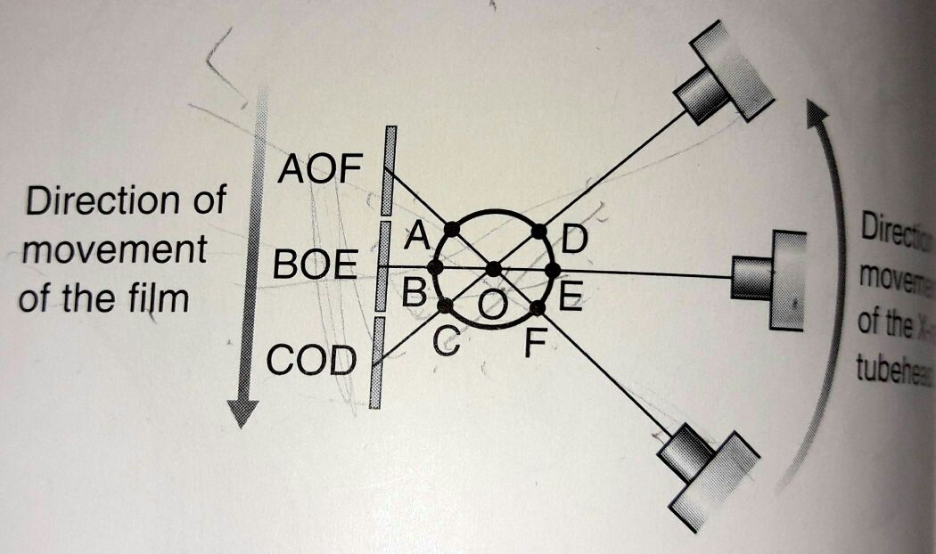
PRINCIPLE
Tomography requires controlled, accurate rate movement
During the exposure, x-ray tubehead moves in one direction while film in opposite direction.
The point at the centre of rotation will appear in focus on the resultant radiograph.
All the other forms appear blurred.
Notes:
2) They are therefore linked together
4) The point at the contre of rotation will appear in focus on the resultant radiograph, since its shadow will appear in the same place on the film though out the exposure.

Slide 14
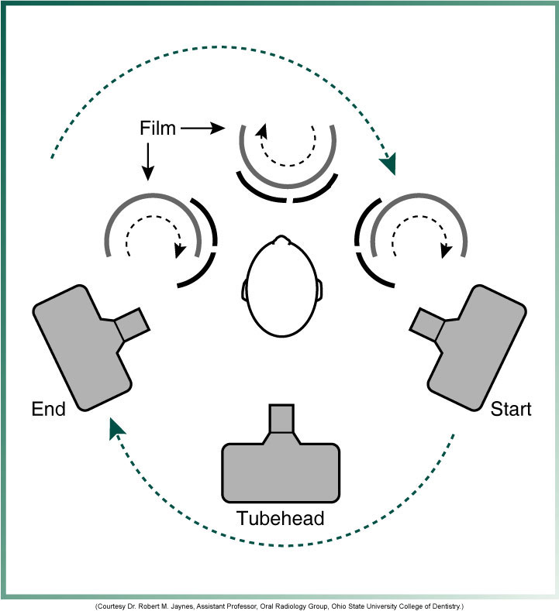
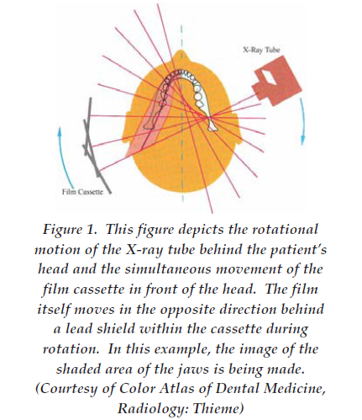
The film and x-ray tube head move around the patient in opposite directions in panoramic radiography

Slide 15
ROTATION CENTER
The pivotal point or axis around which the cassette carrier and tube head rotate is termed rotation center
Three basic rotation center used in panoramic radiography
Double centre rotation
Triple centre rotation
moving centre rotation
The location and number of rotational centers influence size and shape of focal trough

Slide 16
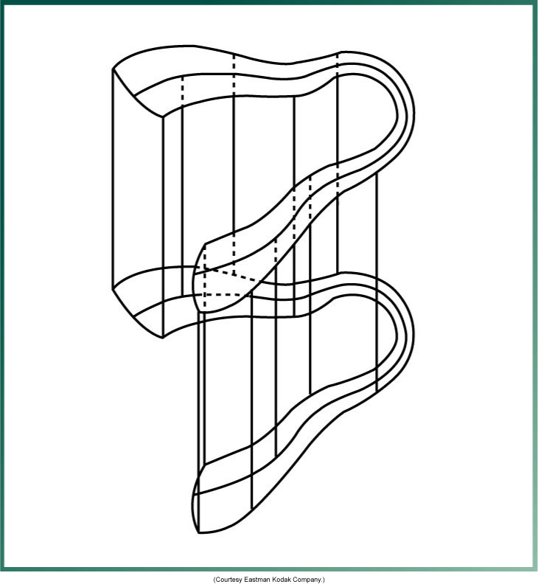
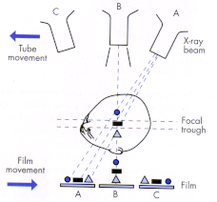
FOCAL TROUGH
Notes:
FOCAL TROUGH – zone which contains those object points which are depicted with optimum resolution
FACTORS AFFECTING SIZE OF IMAGE LAYER:
Arc path
Velocity of receptor and X-ray tube head
Alignment of x-ray beam
Collimator width
The location of image layer change with extensive machine used so recalibration may be necessary if consistently suboptimal images are produced.
As a position of object is moved within the image layer size and shape of image layer change.

Slide 18
REAL, DOUBLE AND GHOST IMAGE

Slide 19
DOUBLE IMAGE
GHOSTIMAGE
REAL IMAGE

Slide 20
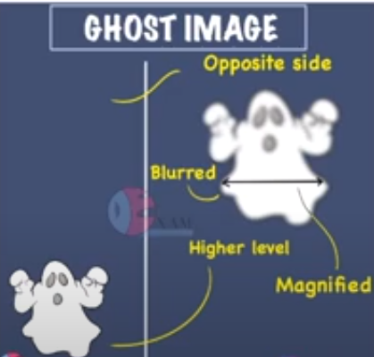

Slide 21
INDICATIONS
As a substitute for full mouth intraoral periapical radiographs.
For evaluation of tooth development for children, the mixed dentition and also the aged.
To assist the patient for and during orthodontic treatment
To establish the site and size of lesions such as cysts, tumors and developmental anomalies in the body and rami of the mandible.

Slide 22
Prior to any surgical procedures such as extraction of impacted teeth, enucleation of a cyst, etc.
For detection of fractures of the middle third face and the mandible after facial trauma.
For follow-up of treatment, progress of pathology or postoperative bony healing.
Investigation of TM joint dysfunction.
Periodontal disease—as an overall view of the alveolar bone levels.

Slide 23
To measure the density of bone
In forensic ondontology

Slide 24
CONTRAINDICATION
Panoramic radiography is generally considered to be unstable for children under six years old, because of the length of the exposure and the need for the patient to keep still.
Patient who are unconscious
Parkinson's disease

Slide 25
ADVANTAGES
Simple procedure requiring very little patient compliance.
Convenient for the patient.
Useful in patients with trismus and gagging problems.
Time required is minimal compared to a full mouth intraoral periapical radiographs.
The patient dose is relatively low.
Panoramic radiographs taken for diagnostic purpose are valuable visual aid in patient education.

Slide 26
A broad anatomic region is imaged.
It allows for the assessment of the presence and position of un-erupted teeth in orthodontic treatment.
It demonstrates periodontal disease in a general way.
On recall visits for comparative and research purposes.
Notes:
In addition
to the teeth and the supporting structures, the
entire maxillary region and the entire mandible
extending distally up to the TM joint is
visualized. Also seen in the same plate are the
pharyngeal air spaces, hyoid bone and the
styloid process.

Slide 27
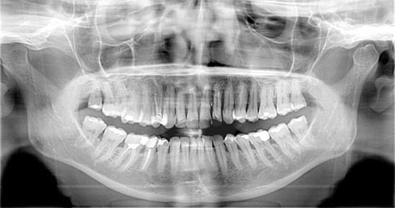
DISADVANTAGES
Areas of diagnostic interest outside the focal trough may be poorly visualized, e.g. swelling on the palate, floor of the mouth.
There is an overlapping of the teeth in the bicuspid area of the maxilla and the mandible.
In cases of pronounced inclination, the anterior teeth are poorly registered.
Number of radiopaque and radiolucent areas may be present due to the superimposition of real/double or ghost images and because of soft tissue shadows and air spaces.

Slide 28
If the patient positioning is improper, the amount of vertical and horizontal distortion will vary from one part of the film to another part of the film.
OPG shows an oblique, rather than true lateral view of the condylar heads and hence, the joint space cannot be accurately assessed.
The cost of the machine is high.

Slide 29
PART 2

Slide 30
PROCEDURE

Slide 31
The Basic Steps
1. Set exposure factors, if required.
2. Have patient remove jewelry; place apron on patient’s back and shoulders.
3. Have patient bite on bite rod.
4. Adjust the: a. chin tilt with the Frankfort light. b. head rotation with the mid-sagittal light. c. forward/backward head position with the canine light.
5. Position the side guides or head support.
6. Have the patient stand up straight.
7. Have patient swallow, place tongue on roof of mouth, and hold still.
8. Take X-ray
Notes:
There are several basic steps in taking a panoramic radiograph. These steps will apply to almost any panoramic machine, while some machines have features such as automatic exposure, which reduce the likelihood of exposure error, but do not prevent them entirely. It is important to know the steps and how they affect the outcome of the radiographic process. When problems occur at any of the steps they will cause unique errors on the resulting radiographs that when recognized, are easy to correct.

Slide 32
Step 1: Setting Exposure Factors
Many newer panoramic machines set exposure factors automatically by measuring the amount of radiation passing through the patient’s head, or by measuring head width and adjusting exposure values accordingly.
With some panoramic machines, though, exposure must be set based on the patient’s size or age.
Notes:
Since the patient’s bone density is not always related to their physical size, a better guide is to look at the patient’s wrists or ankles. Thick wrists can imply heavier bone density; other factors to consider are age, whether the patient is edentulous, and obesity.

Slide 34
Underexposure: note light, washed out image

Slide 35
Step 2: Have Patient Remove Jewelry, Place Lead Apron on Patient
Notes:
Prior to exposure, the patient must remove all jewelry from the head area. The panoramic exposure encompasses the whole head. Earrings, necklaces, or other jewelry, such as tongues bars or nose rings will be visible on the radiograph.

Slide 37
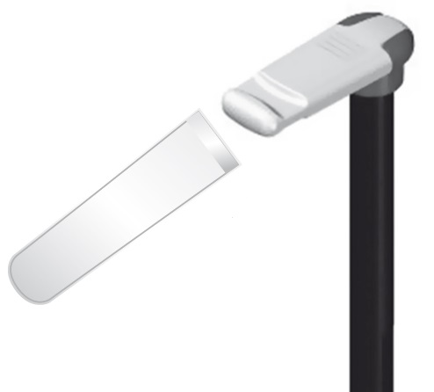
Step 3: Bite on Rod
Most panoramic machines use a bite rod made of plastic with small grooves to position the patient’s anterior teeth in the focal trough.
Most machines also offer an edentulous guide that is placed against the patient’s chin or under the nose.
Notes:
Most machines offer a correction for these cases. Many machines offer an aiming device centered on the mandibular cuspid, as it is considered to be more indicative of the patient’s skeletal position.

Slide 38
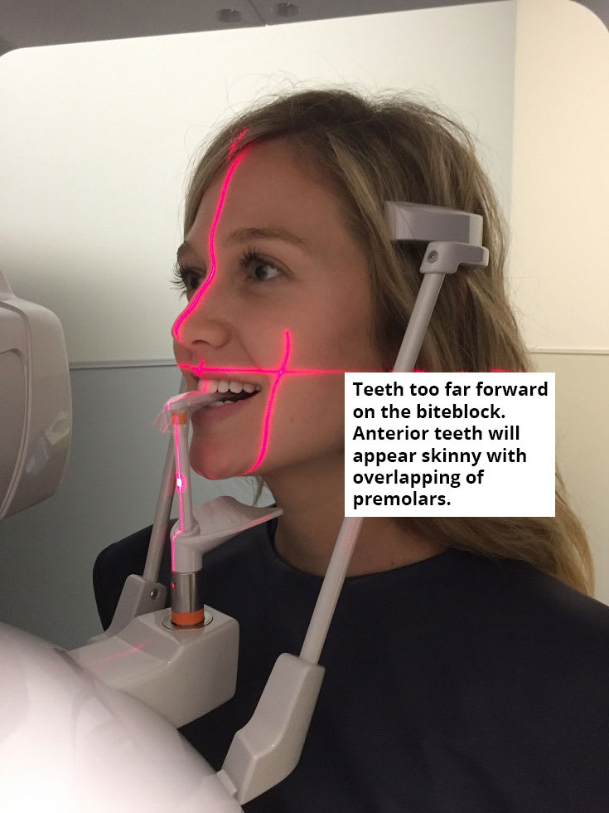

Slide 39
Patient too far forward; note spine superimposed over rami, blurring, and narrowing of anterior teeth

Slide 40
Patient too far back; note ghosting of mandible and spine, condyles pushed to outside of film, blurring and widening of anterior teeth

Slide 41
Step 4: Adjust Chin Tilt
In the panoramic radiograph the patient should be looking slightly down at a spot on the floor approximately 8 feet in front of them.
This elevates the posterior palate so it does not overlap the apices of the maxillary teeth in the final image.
This is often referred to as “chin tilt.”
Having the patient’s chin tipped too far down is the most common panoramic error.

Slide 42
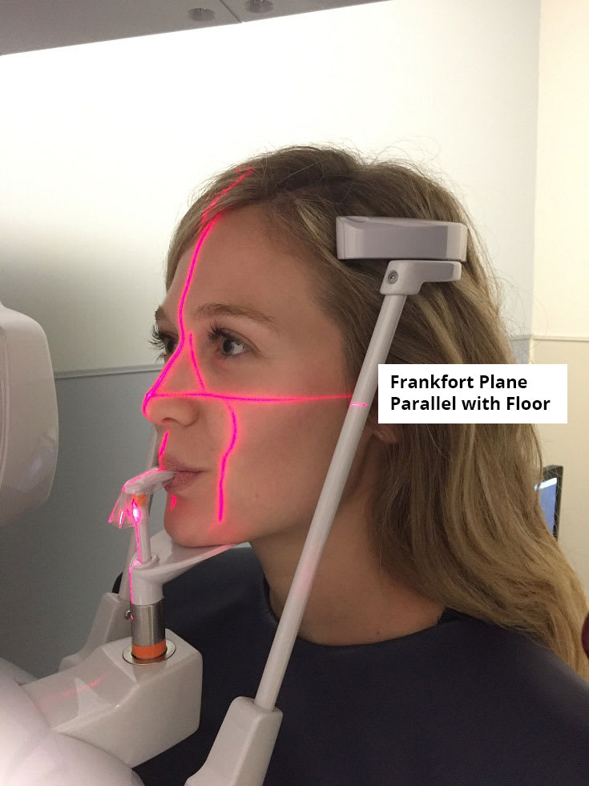
The midsagittal plane should be perpendicular to the floor and aligned with the vertical center of the chin rest, and the Frankfurt plane should be parallel to the floor, thus obtaining the correct position for the occlusal plane (The patient's head is tilted downwards so that the tragus ala line is 5° down and forward).

Slide 44
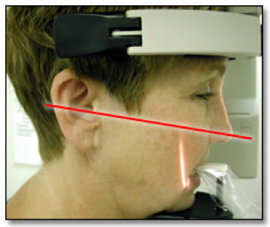
Chin tipped down; note V-shaped mandible, extreme smile line, arching of spine at top of image, condyles placed high on film, and streaking of the hyoid bone over the mandible

Slide 45
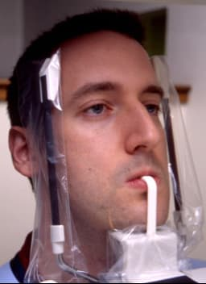
Chin up too high; note flattened occlusal plane, palate superimposed on maxillary tooth roots, and broad flat mandible

Slide 46
Step 5: Position and Close Side Guides
All panoramic machines will have guides or positioning lights to align the patient’s midsagittal plane.
It is important that the patient be looking straight ahead with no tip or tilt to the head.
Side guides or head and temple supports may be used and may come from either the top or the bottom of the machine.
When the patient’s head is twisted, it is similar to being too far forward on one side and too far back on the other.

Slide 48
Head twisted; note uneven width of rami, unequal magnification of teeth, and condyles

Slide 49
Step 6: Have Patient Stand Up Straight
The patient must be standing up straight to prevent arching of the neck (slumping).
The best method of achieving this is not to allow the patient to reach forward to the bite stick or chin rest.
Have the patient take a step forward after they are biting on the rod.
They should feel somewhat as if they will fall backward if they let go of the hand-holds.
This will avoid problems with the system hitting the shoulders and spinal ghosting

Slide 51
Slumped; note the white spine shadow in midline

Slide 52
Step 7: Have Patient Swallow, Place Tongue in Roof of Mouth, and Hold Still
Just before the exposure is made, the patient is instructed to swallow, place the tongue on the roof of the mouth, and hold still during the exposure.
Failure to do these things can result in patient movement artifacts or airway obscuring vital portions of the image.
In particular, not placing the tongue in the roof of the mouth results in a large airway shadow directly over the roots of the maxillary teeth

Slide 53
Tongue down during exposure; note shadow of air space over roots of maxillary molars, airway space over rami

Slide 54
Patient movement; note step defect in inferior border of mandible

Slide 55
Step 8: Exposure
Problems during exposure are primarily due to machine or operator errors including letting go of exposure button temporarily (not possible with most recent machines), changing exposure settings during the exposure.

Slide 57
NORMAL ANATOMICAL LANDMARKS

Slide 58
landmarks
MAXILLARY OR MIDFACIAL BONY ANATOMICAL STRUCTURES

Slide 59
MANDIBULAR BONY ANATOMICAL STRUCTURES

Slide 60
SPINAL, NECK AND SOFT TISSUE ANATOMICAL STRUCTURES

Slide 61
SUMMARY OF COMMON ERRORS
Ghost images
Lead apron artifact
Patient positioning errors
Cassette positioning errors

Slide 62
LEAD APRON ARTIFACT

Slide 63
PATIENT POSITIONING ERRORS
i. Positioning of the lips and teeth
ii. Positioning of the Frankfurt plane
a. Upward
b. Downward
iii. Positioning of the teeth
a. Anterior to the focal trough
b. Posterior to the focal trough
iv. Positioning of the midsagittal plane
a. Patient's head is tilted to one side.
b. Patient's head is twisted to one side
c. Whole head is off center position
v. Positioning of the spine
vi. Patient's shoulder touching the cassette during exposure
vii. Position of patient's tongue during exposure
viii. Distortion due to patient movement
Notes:
Patient's shoulder touching the cassette during exposure----This will slow the cassette rotation, resulting in prolonged exposure or completely stop the film movement.
– Produces a dense black band, which is the area of overexposure or a dense black edge may be seen at the end of the radiographic image, due to eventual stoppage of rotation.
. Distortion due to patient movement:
a. Movement in the same direction as the beam.
b. Movement in the opposite direction as the beam.
c. Sudden jerky movement in the same direction as the beam.
d. Sudden jerky movement in the direction opposite the beam movement.
e. If the patient moves up or down during exposure.

Slide 64
REAL, DOUBLE AND GHOST IMAGES

Slide 65
DEPENDING UPON THE LOCATION, OBJECTS MAY CAUSE THREE DIFFERENT TYPES OF IMAGES ON AN OPG.
REAL IMAGE
DOUBLE IMAGE
GHOST IMAGE

Slide 66
REAL IMAGE
FORMED BY OBJECTS THAT LIE BETWEEN THE CENTRE OF ROTATION AND RECEPTOR

Slide 67
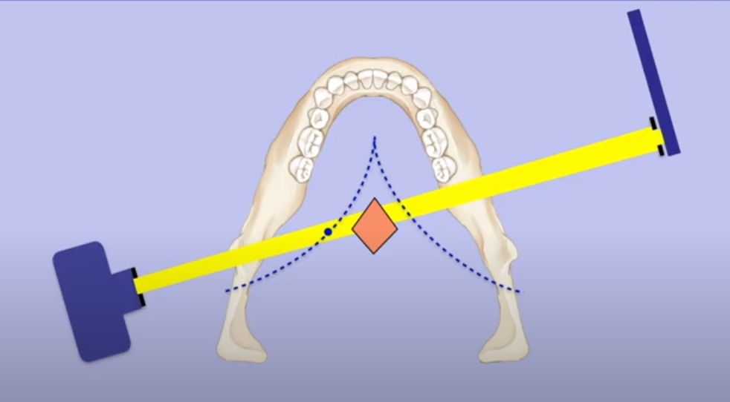
DOUBLE IMAGE
OBJECTS THAT LIE POSTERIOR TO CENTRE OF ROTATION AND THAT ARE INTERCEPTED TWICE BY THE X RAY BEAM FORM DOUBLE IMAGE.
RECEPTOR
X RAY SOURCE
CENTRE OF ROTATION

Slide 69
STRUCTURES WHICH CAUSE DOUBLE IMAGES

Slide 70
GHOST IMAGES
OBJECTS LOCATED BETWEEN THE CENTRE OF ROTATION AND X RAY SOURCE CAST GHOST IMAGES
ANATOMICAL STRUCTURES which are most often ghosted are
i. Hyoid bone
ii. Cervical spine
iii. Inferior border of the mandible
iv. Posterior border of the mandible
NON-ANATOMICAL STRUCTURES which are often ghosted are:
i. Chin rest
ii. (R) or (L) Markers of the machine
iii. Neck chains and Earrings
iv. Shoulder straps of protective aprons.

Slide 72
EXAMPLE 1

Slide 74
REASON WHY GHOST IMAGE APPEARS AT A HIGHER LEVEL

Slide 75
EXAMPLE 2

Slide 76
EXAMPLE 3 GHOST IMAGE OF ANATOMICAL STRUCTURE

Slide 78
IDENTIFY THE GHOST IMAGE

Slide 79
IDENTIFY THIS

Slide 81
Conclusion
Panoramic radiography provides the dentist with an image of the whole dentition and adjacent structures.
While panoramic radiography is technique sensitive, by carefully following the steps outlined, clear and undistorted radiographs of high diagnostic quality can be consistently obtained.
In today’s digital age, capturing and storing panoramic radiographs is a reliable procedure that if combined with practice management software enables the patient’s image to be recalled together with his file when needed.

Slide 82
References
Oral Radiology- Principles and Interpretation by Stuart C. White and Michael J. Pharoah, First South Asia edition
Textbook of Dental and Maxillofacial Radiology by Freny R Karjodkar, Second edition
Textbook of Radiology by Anil Govindrao Ghom
Digital Radiography in Dentistry: Moving from Film-based to Digital Imaging

Slide 83
THANK YOU

