Slide 1
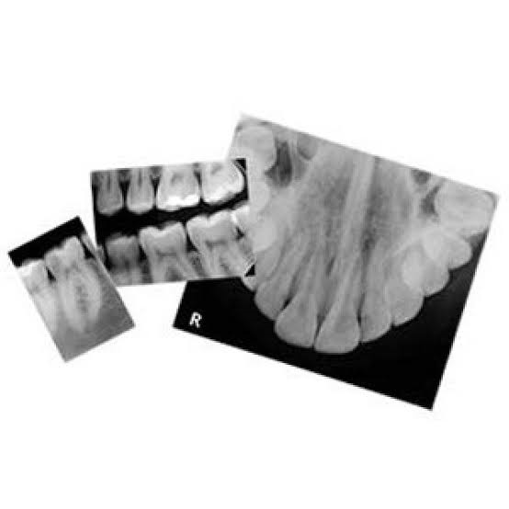
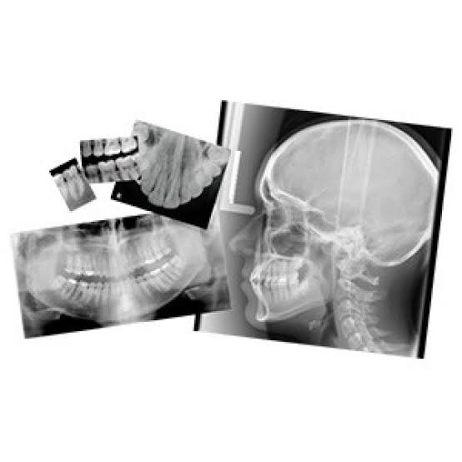
DEPARTMENT OF ORAL MEDICINE AND RADIOLOGY
FILM IMAGING
Dr. Pratima Soni
Senior Lecturer

Slide 2
CONTENTS
INTRODUCTION
X- RAY FILMS
DISCRIPTION OF FILMS

Slide 3
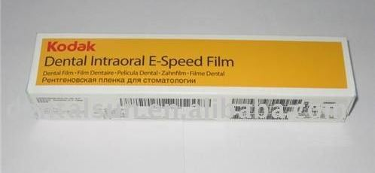
INTRODUCTION
A beam of x- ray photons that passes through the dental arches is reduced in intensity by absorption and scattering of photons out the primary beam.
The pattern of the photon that exists the patient, the remnant beam, conveys information about the patients anatomy.
For this information to be useful diagnostically, the remnant beam must be recorded on an image receptor.
The image receptor most often used in dental radiography is X- ray film.

Slide 4
CONTENTS
INTRODUCTION
X- RAY FILMS
INTENSIFYING SCREENS
CASETTES

Slide 5
CLASSIFICATION OF X RAY FILMS
BASED ON USE
INTRAORAL
EXTRAORAL
1.PERIAPICAL
2. OCCLUSAL
3. BITE WING

Slide 6
CLASSIFICATION OF X RAY FILMS
BASED ON SPEED
SLOW SPEED FILMS
FAST SPEED FILMS
HYPERSPEED G FILMS
1. Very small grains of silver bromide
2. Emulsion on one side
3. Better definition
4. Greater Exposure
1. Larger grains of silver bromide
2. Emulsion on both side
1. Can significantly reduce patient exposure
A,B,C Speed
D-ULTRA
E- EKTA
F- ULTRA EKTA

Slide 7
CLASSIFICATION OF X RAY FILMS
BASED ON USE OR NON USE OF SCREENS
SCREEN FILMS
NON SCREEN FILMS
SENSITIVE TO BLUE LIGHT
SENSITIVE TO GREEN LIGHT

Slide 8
INTRAORAL FILMS
CLASSIFICATION
SIZES OF INTRAORAL FILMS
DESCRIPTION OF FILMS
CONTENTS
COMPOSITION

Slide 9
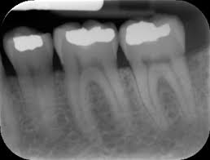
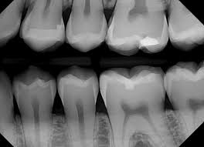
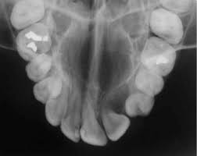
CLASSIFICATION OF INTRAORAL FILMS
BASED ON USE
PERIAPICAL FILMS
BITEWING FILMS
OCCLUSAL FILMS

Slide 10
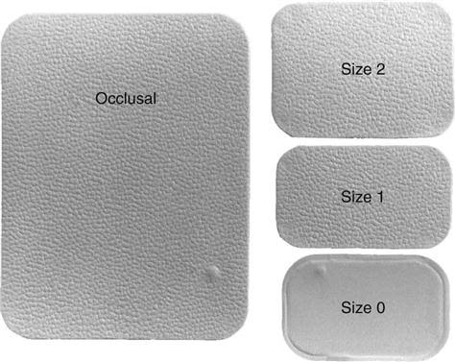
SIZES OF IOPA FILMS
30.5 * 40.5 mm
24 * 40 mm
22 * 35 mm
57 * 76 mm

Slide 11
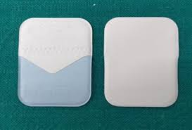
DESCRIPTION OF INTRAORAL FILMS
LABEL SIDE
TUBE SIDE

Slide 12
DESCRIPTION OF INTRAORAL FILMS
OUTER PLASTIC WRAPPING
2 SIDES
1. TUBE SIDE
2. LABEL SIDE
LABEL SIDE
TUBE SIDE
EMBOSSED DOT
ROUNDED CORNERS

Slide 13
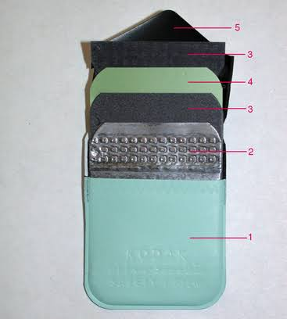
CONTENTS OF INTRAORAL FILMS
WATERPROOF OUTER COVER
BLACK PAPER
FILM
BLACK PAPER
LEAD FOIL BACKING
WATERPROOF OUTER COVER

Slide 14
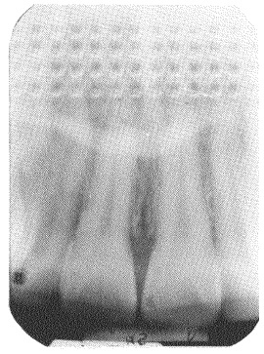
PURPOSE OF LEAD FOIL
Absorbs X-rays which pass through the film and prevent them from reaching tongue and other structures
Secondarily gives stiffness but not rigidity to whole film packet
Absorbs back scatter radiation and prevents fogging

Slide 15
WHAT HAPPENS IF THE FILM IS PLACED IN REVERSE
Shadow of the foil is seen on the resultant radiograph
TYRE TRACK or HERRINGBONE APPEARANCE

Slide 16
PURPOSE OF BLACK PAPER
Protect it form light leak

Slide 17
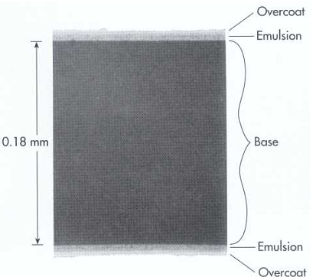
COMPOSITION OF THE X RAY FILM
PROTECTIVE LAYER
EMULSION
ADHESIVE LAYER
BASE
EMULSION
ADHESIVE LAYER
PROTECTIVE LAYER

Slide 18
BASE
Transparent supporting material
on which the emulsion is coated
Polyethylene terephthalate (Polyester)
Thickness = 0.2mm

Slide 19
PROPERTIES OF THE BASE
Should have proper amount of flexibility to allow ease of handling
Translucent, casting no pattern on the resultant radiograph
Should have a Bluish tint for optimal viewing of the diagnostic detail
Should be able to withstand exposure to processing solutions without distorting, heat, moisture and chemical exposure

Slide 20
ADHESIVE LAYER
TO ENSURE GOOD ADHESION TO THE SENSITIVE EMULSION LAYER AND THE BASE

Slide 21
EMULSION
CONSISTS OF
SILVER HALIDE CRYSTALS
1. Silver bromide (80-99%)
2. Silver iodide (1-10%)
3. Mean diameter of silver Halide grain is 0.70 – 0.75 mm
4. Silver halide crystals absorb radiation during X-Ray exposure and store energy from the radiation
5. SILVER IODIDE – Adds greatly to the sensitivity of the film emulsion, thereby reducing the radiation dose required to produce an adequate diagnostic image
GELATIN MATRIX
1. Made from cattle bone and helps to keep the silver grain evenly dispersed.
2. During processing the gelatin absorbs the processing solutions and helps to allow the chemicals to react with the halide grains
Insight(1.8 um dia)
Coated on both the sides
Photosensitive to visible light and X-rays

Slide 22
PROTECTIVE LAYER
It is a protective, transparent, nonabrasive layer over the emulsion.
An additional layer of Gelatin over the emulsion to serve as a protective barrier
Protects film from damage by mechanical handling, such as scratching, contamination and pressure from rollers during the automatic processing.

Slide 23
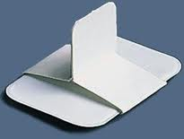
BITEWING FILMS
To record the crowns of Maxillary and Mandibular teeth in one film.
Tab projecting from the middle of the film on which the patient bites to support the film.
Detection of inter-proximal caries
Visualize the alveolar crest and assessment of periodontal disease.

Slide 24
CLASSIFICATION OF X RAY FILMS
BASED ON USE
INTRAORAL
EXTRAORAL
1.PERIAPICAL
2. OCCLUSAL
3. BITE WING

Slide 25
EXTRA ORAL FILMS
An extra-oral film is that which is placed outside the mouth during x-ray exposure
Extra-oral films are used to examine large areas of the skull or jaws

Slide 26
SIZES OF EXTRAORAL FILMS
LATERAL OBLIQUE FILM: 5×7 inches
PANORAMIC FILM: 6×12 inches
CEPHALOMETRIC FILM: 8×10 inches
SKULL RADIOGRAPHY: 10×12 inches

Slide 27
In extra-oral radiography, screen films are used in combination with two special equipment items:- 1)Intensifying screens 2) Cassettes

Slide 28
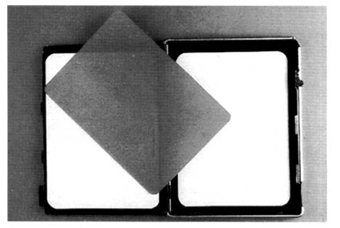
SCREEN FILMS
A screen film is placed between two special intensifying screens in a cassette.
When the cassette is exposed to x-rays, the screens convert the x-ray energy into light, which in turn exposes the screen film.
Screen film is sensitive to fluorescent light rather than direct exposure to x-radiation.
BLUE LIGHT SENSITIVE GREEN LIGHT SENSITIVE

Slide 29
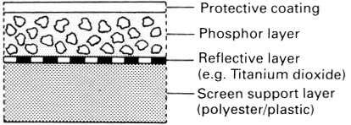
INTENSIFYING SCREENS
An Intensifying Screen, is a device that transfers x-ray energy into visible light, the visible light, in turn, exposes the screen film. These screens intensify the effect of X-RAYS on the film, thus less radiation is required to expose a screen film, and thus the patient is exposed to less radiation.

Slide 30
An intensifying screen is a smooth plastic sheet coated with minute fluorescent crystals known as PHOSPHORS.
When exposed to x-rays, the phosphors FLUORESCE and emit visible light in the blue or green spectrum; the emitted light then exposes the film.

Slide 31
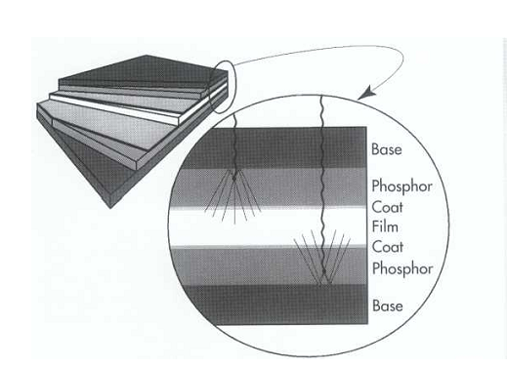
COMPOSITION
BASE-. It is about 0.25mm thick.
The base is the supporting component of the screen.

Slide 32
REFLECTING LAYER
Serves to redirect the film a large fraction of the emitted visible light which is moving away from the film.
Thus it increases the sensitivity but some degree of un-sharpness is created because of divergence of light emitted back to the film.

Slide 33
PHOSPHOR LAYER-
Composed of phosphorescent crystals, which absorb x ray photons and fluoresce.
Rare earth intensifying screens using
terbium-activated gadolinium oxysulphide and
thelium-activated lanthanum oxybromide,
fluoresce in the green portion of the spectrum.

Slide 34
COAT- This layer protects the phosphor layer from mechanical insult such as abrasion, scratching etc.

Slide 35
CASSETTE
A CASSETTE is a special device that is used to hold the extra-oral film and the intensifying screen.
Cassettes are available in a variety of sizes that correspond to the film and screen sizes.

Slide 37
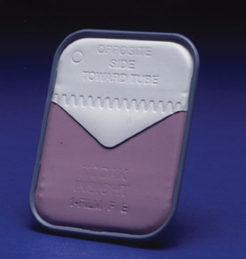
IMAGE- PICTURE OR LIKENESS OF AN OBJECT. RECEPTOR- THAT RESPONDS TO A STIMULUS. Images are recorded on the dental x ray film when the film is exposed to a stimulus-specifically energy in the form of X radiation or light.

